Slide 1
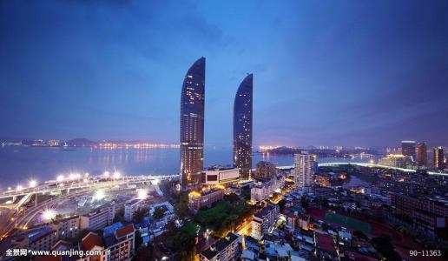
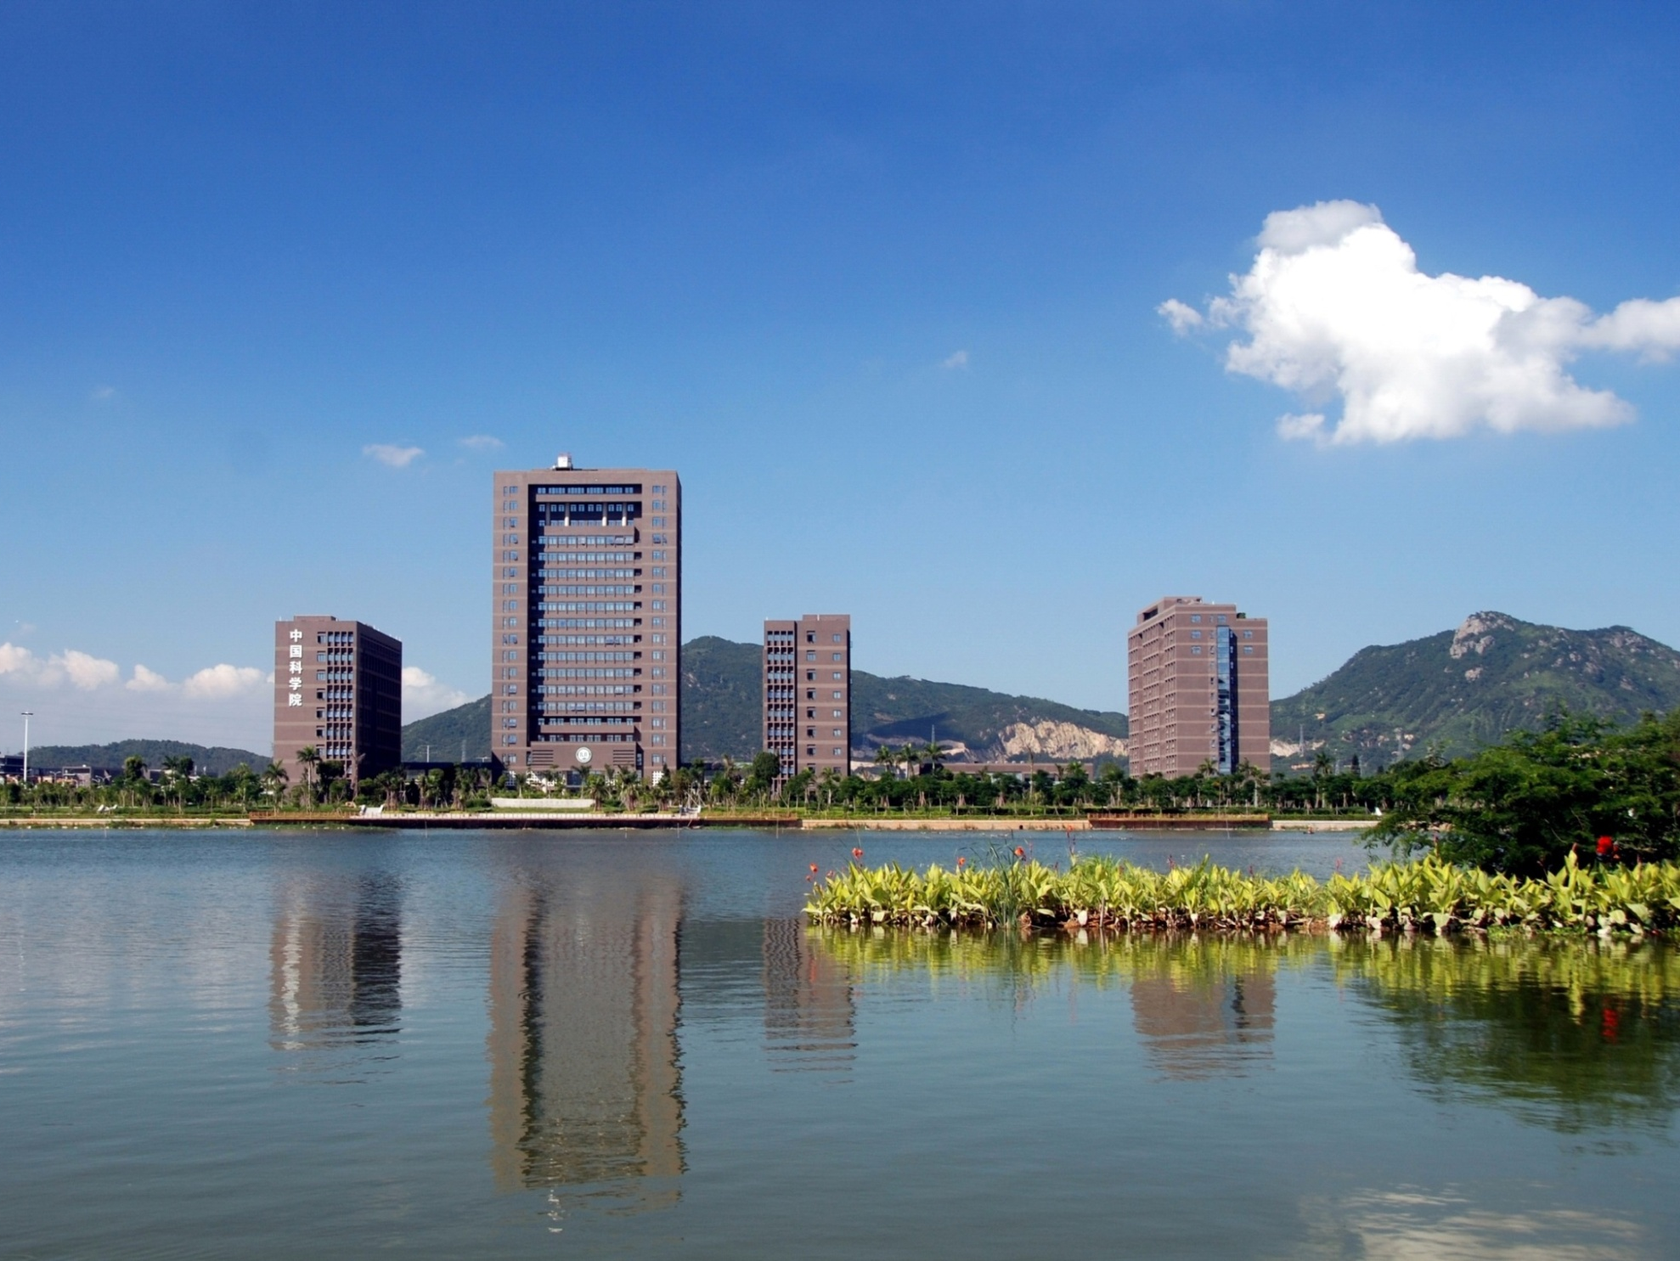
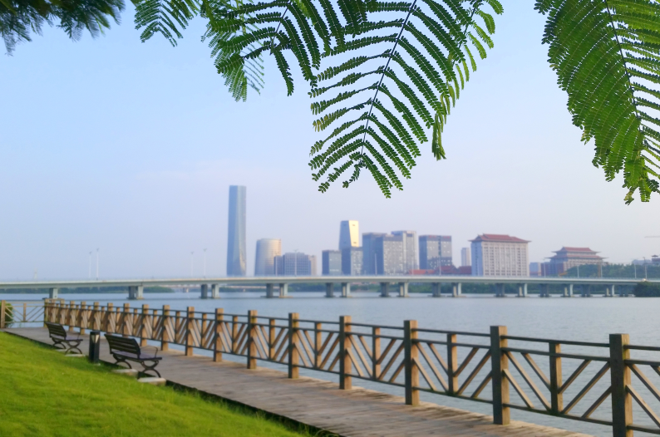
Estimating spatiotemporal dynamics of solid wastes by coupling MFA & GIS
Assist. Prof. Yupeng Liu (刘宇鹏)
Prof. Wei-Qiang Chen (陈伟强)
Institute of Urban Environment, Chinese Academy of Sciences
Notes:
Thank you Paul for giving us this opportunity to show our work on…
I am YP Liu. I am an assistant professor in Weiqiang’s group.
Both of us are faculty members in IUE, CAS.

Slide 2
Urban big data
Notes:
My background is remote sensing, GIS, and urban ecology. Weiqiang is industrial ecology, he is familiar with MFA LCA.
That is why I try to couple SA and MFA to study urban metabolism and that is why we meet Paul and his colleagues.
What we have done is that we collect urban data

Slide 3
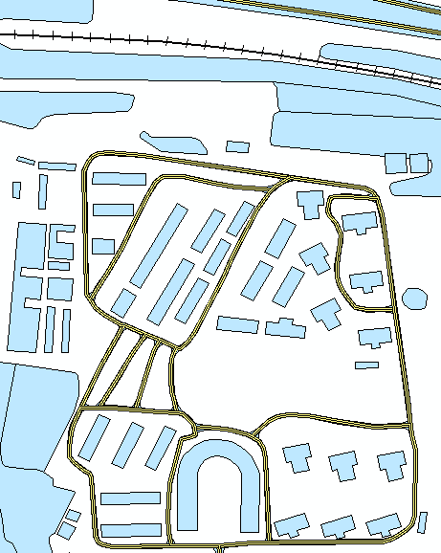
“SimCity”
Building
Pos
Area
Floor
Struct
YRB
Usage
Railway
Pos
YRB
Length
Struct
Road
Pos
Width
Struct
YRB
Length
Subway
Pos
Length
Struct
YRB
Notes:
To build a city simulator in our computers

Slide 4
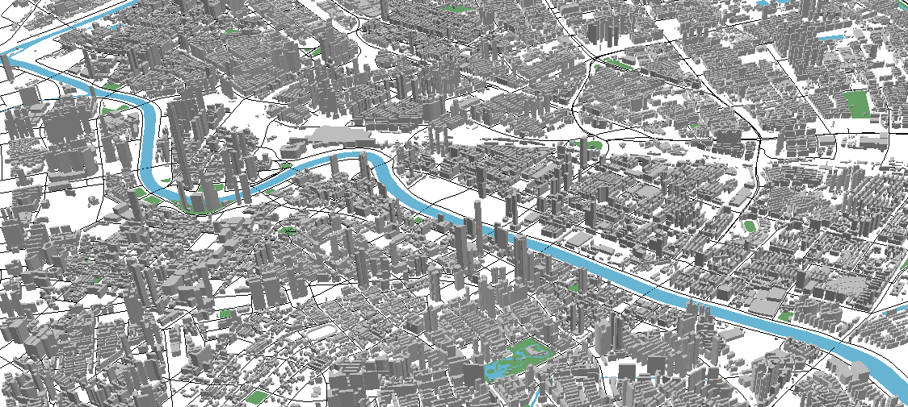
3-D city
Notes:
It could be a 3-D city

Slide 5
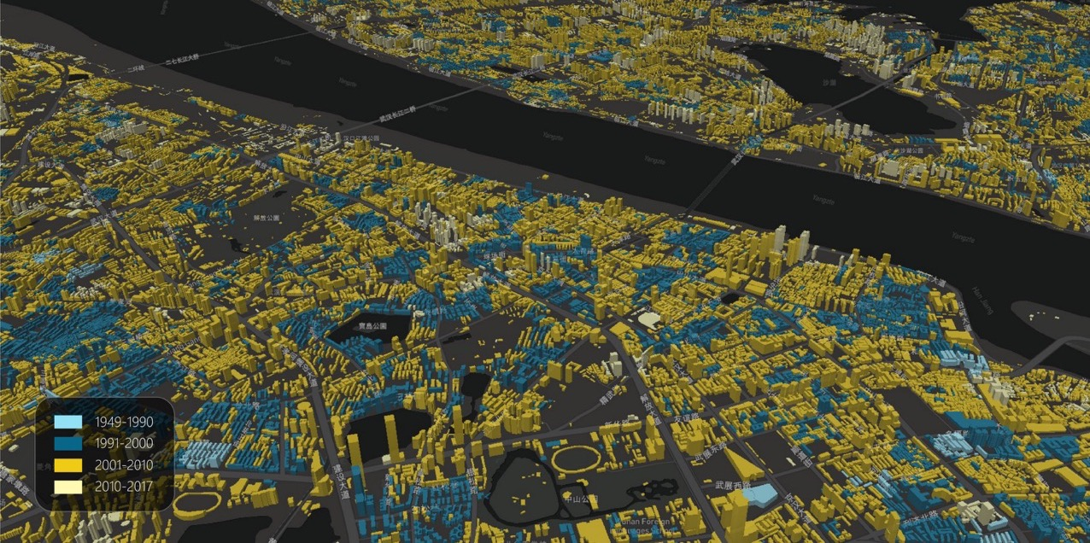
Year of Built
Notes:
And we know buildings’ dynamic

Slide 6
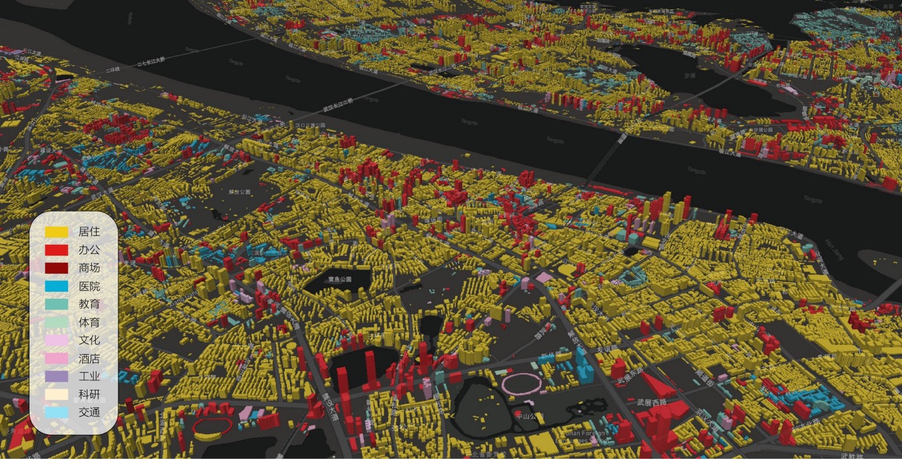
Building utility
Notes:
What their utilities?

Slide 7
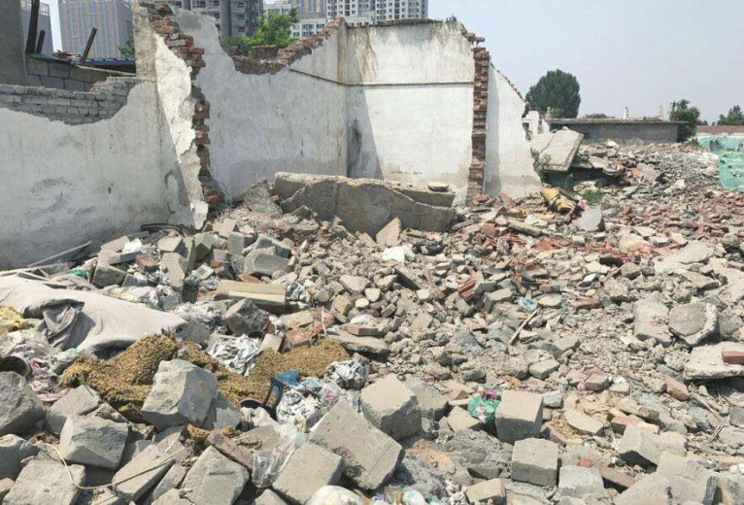
Solid waste
Xiamen case
Notes:
Based on these information we estimate for example construction waste in Xiamen,

Slide 8
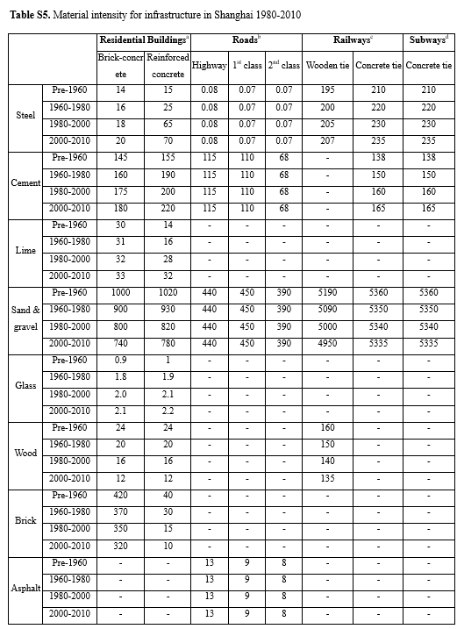
Material stock:
Stock at time t
MS: Material stock (t)
Q: total area (m²)
MI: material intensity (t/m²)
i: type (building, road, railway, subway)
s: structure (i.e. brick concrete, reinforced concrete)
n: year built
（Han et al. Submitted to ES&T）
Notes:
Based on material stock and flow analysis

Slide 9
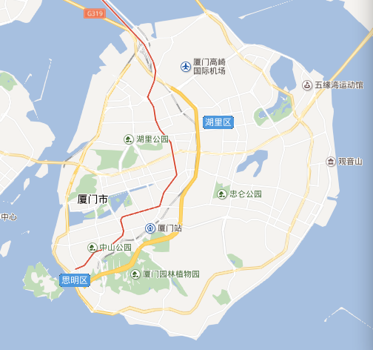
China
Xiamen island
Kulangsu island
Notes:
Xiamen is located at southeast part of China.
We can find two islands on the map. The bigger one is the Xiamen island and the smaller one is the Koolangsu island.

Slide 10
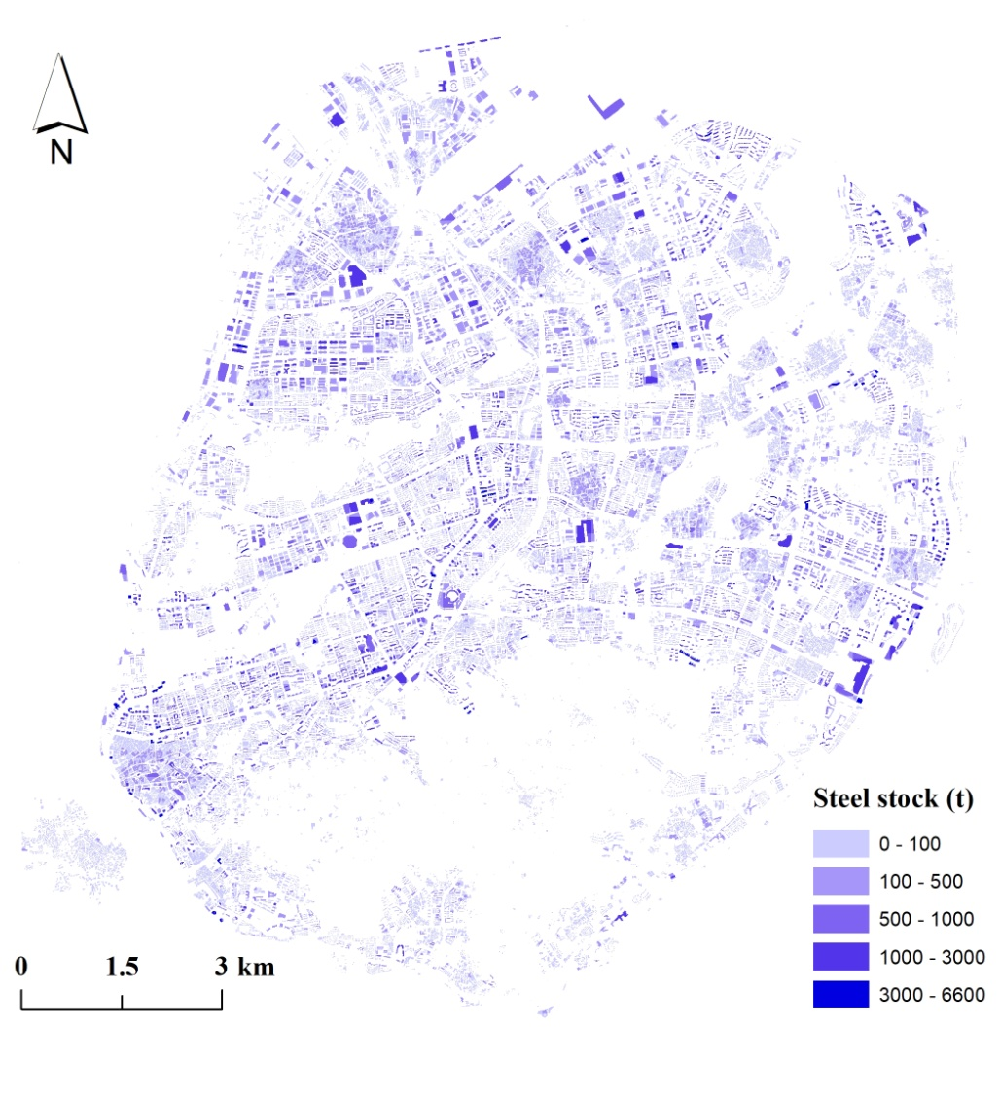
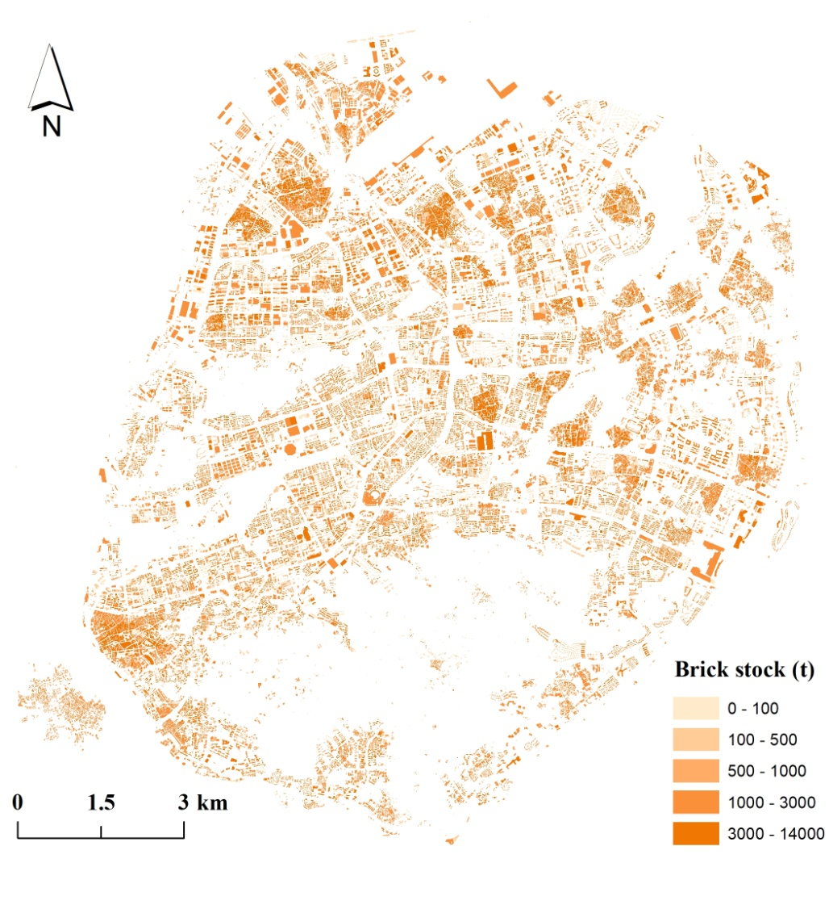
4.7 million tons of steel
(2.3t/capita)
25.1 million tons of brick
(12.4t/capita)
Notes:
A total of 4.7 million tons (2.3 t/capita) of steel and 25.1 million tons (12.4 t/capita) of brick were stored in buildings in 2015
These could be demolished and reused or recycled in the coming future so someone call it urban mining

Slide 11
Height view
Xiamen island
Kulangsu island
Notes:
When we standing on the top of Koolangsu island, we will find this landscape

Slide 12
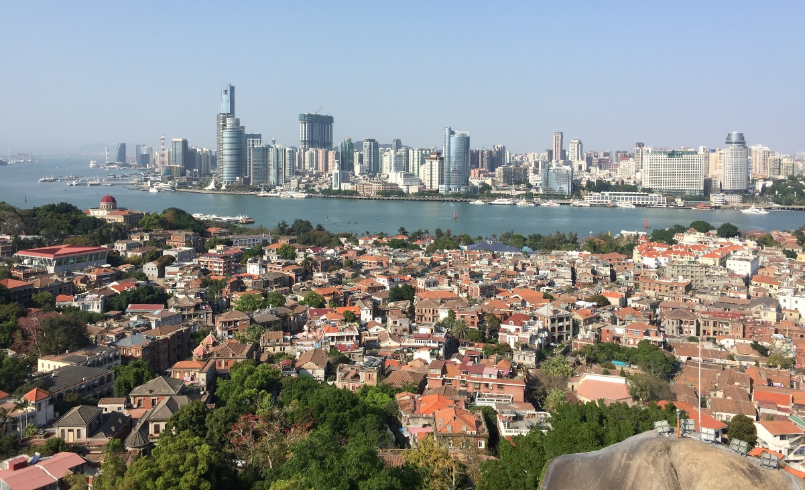
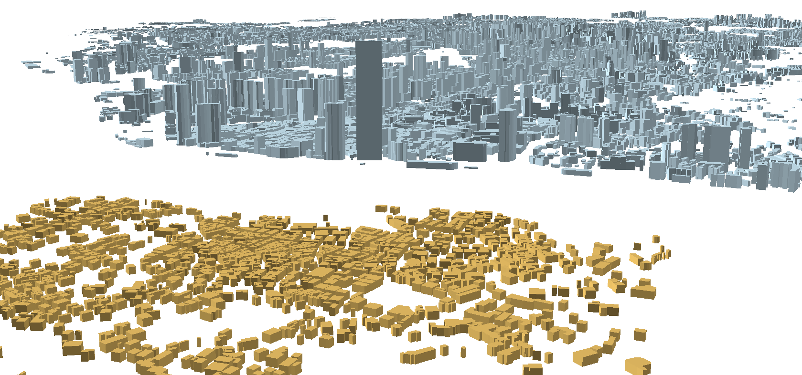
Height view
Xiamen island
Kulangsu island
Notes:
This is a snapshot when I visited the Koolangsu island with Hiroki Tanikawa.
You see,flat buildings vs. skyscrapers

Slide 13
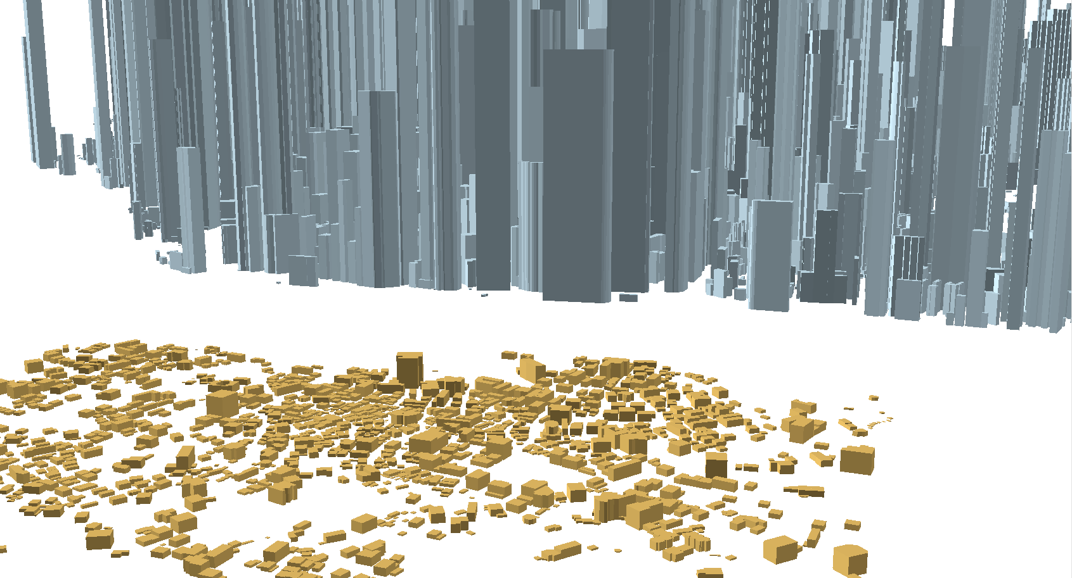
Stock view —— In-use steel
Xiamen island
Kulangsu island
Notes:
From steel perspective, the gap between these two island was widen because most of buildings on the Xiamen island are reinforced concrete structure and used huge amounts of steel.

Slide 14
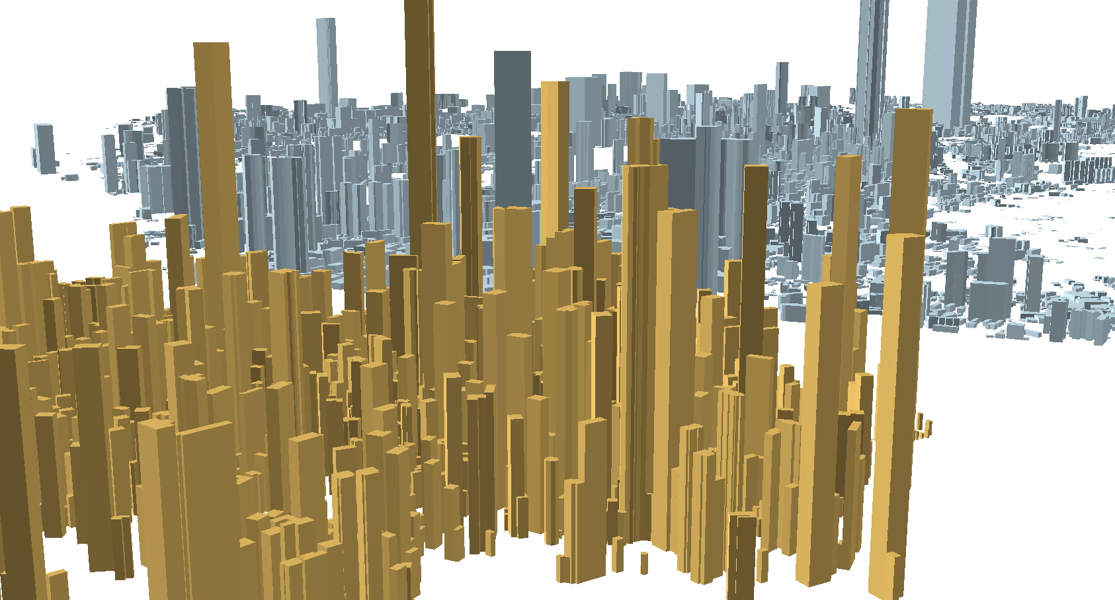
Stock view —— In-use brick
Xiamen island
Kulangsu island
Notes:
But at brick view, the gap between these two islands was filled.

Slide 15
In-use steel | Height | MI
Brick concrete
Reinforced concrete
In-use brick | Height | MI
Brick concrete
Reinforced concrete
Notes:
Because these brick concrete buildings usually have low floors but high brick intensity.
And those reinforced concrete buildings havehigh floors but low brick intensity.
So the total volume seems quite similar.
That is why the spatial pattern of steel stock shows more heterogeneity than brick’s pattern.

Slide 16
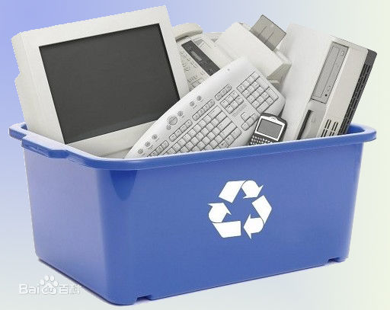
Solid waste
Dongguan case
Notes:
For Dongguan case we focus on E-waste

Slide 17
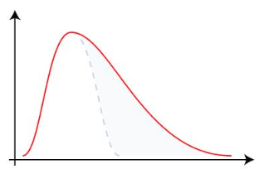
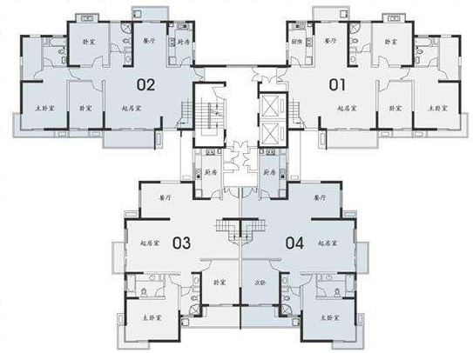
E-waste generation
Year of Built
# of families ×in-use intensity
Service life model：
Ave. life
Notes:
We use spatial information and MFA

Slide 18
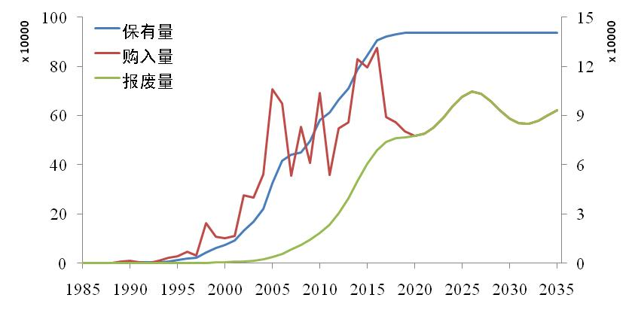
E-waste generation in Dongguan
In-use Stock
Purchase
Waste
Notes:
to simulate E waste generation, pruchase, and stock

Slide 19
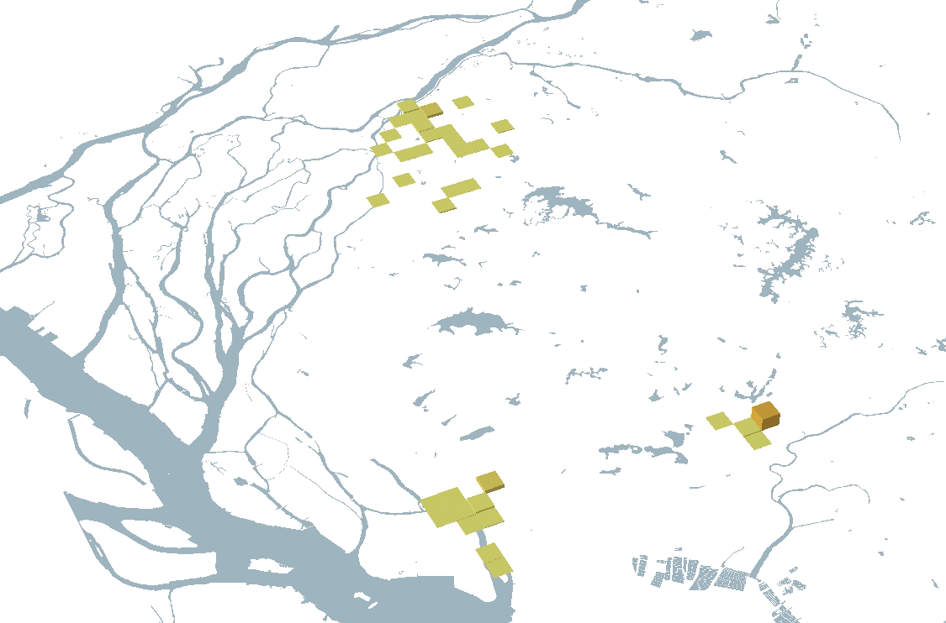
E-waste generation in Dongguan
Dongguan county
# of TV-waste
Chang’an county
Humen county
TV-waste generation from 2000 to 2020
Notes:
We got spatiotemporal dynamics of E-waste generation.

Slide 20
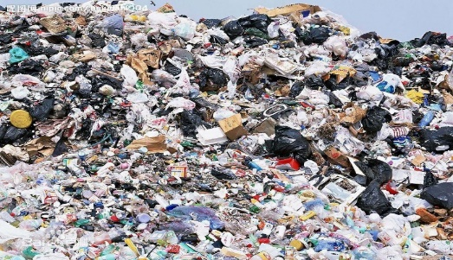
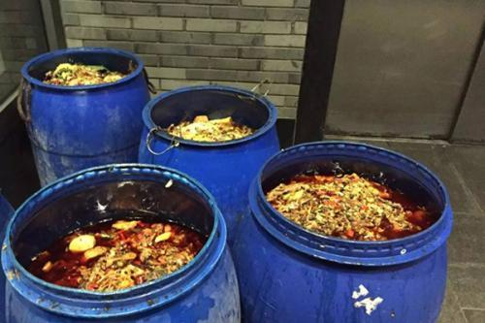
Solid waste
Xiamen case
Dongguan case
Beijing case
Notes:
As the capital of China, we want to do more comprehensive work, and that is why we choose to cooperate with Paul and we have taken a first step

Slide 21
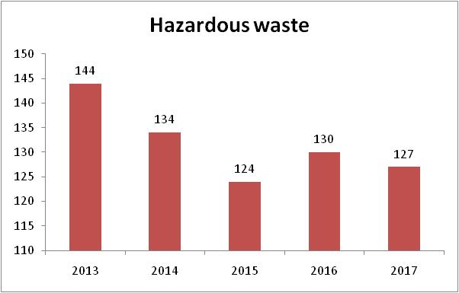
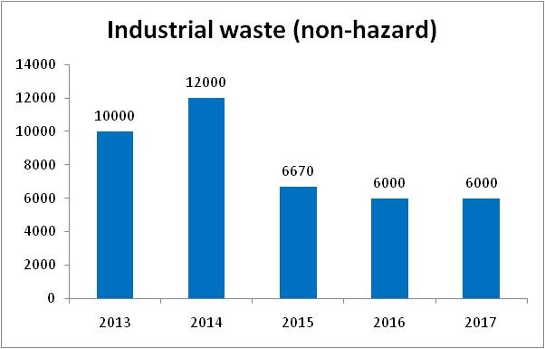
Waste generation from 2013 to 2017
Unit: 10³ tones
Source: Annual Report on the Prevention and Control of Environmental Pollution by Solid Wastes in Large and Medium-sized Cities
Notes:
For the whole picture in Beijing, good new is industrial waste, including hazardous and non hazard declined from 2013 to 2017

Slide 22
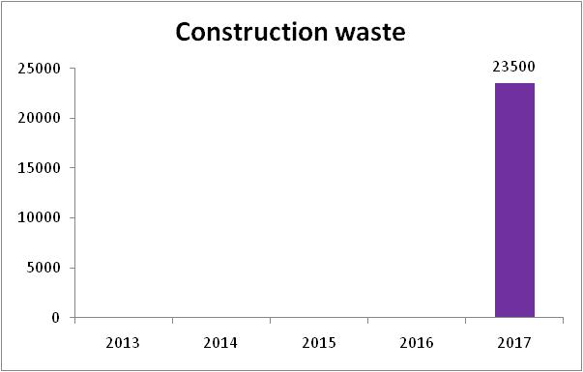
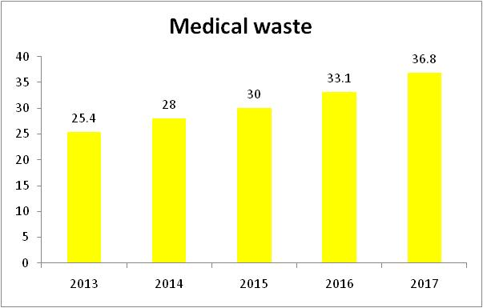
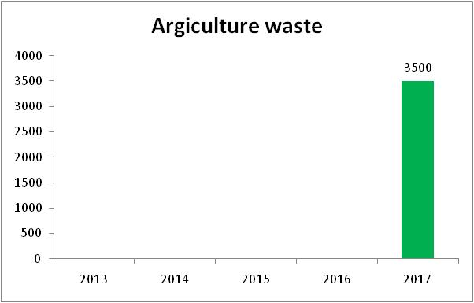
Waste generation from 2013 to 2017
Unit: 10³ tones
Source: Annual Report on the Prevention and Control of Environmental Pollution by Solid Wastes in Large and Medium-sized Cities
Notes:
For medical waste, it is increasing, but not too much.
A rough estimation of construction waste generation is about 23 million tonnes per year, and for agriculture waste is about 3.50 million tonnes per year.

Slide 23
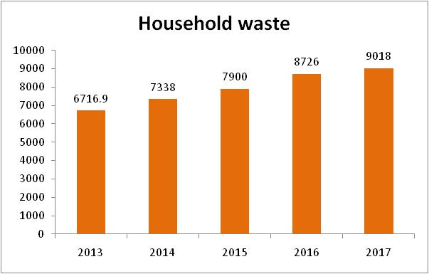
Waste generation from 2013 to 2017
Unit: 10³ tones
Notes:
Household waste generation keeps increase from 2013 and reached 9 million in 2017

Slide 24
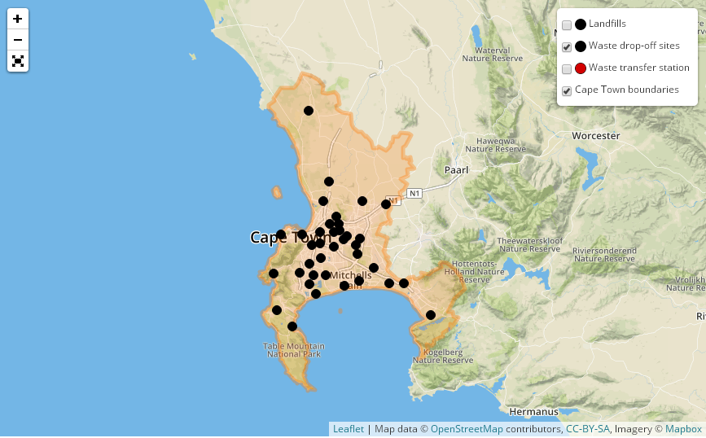
Waste drop-off sites
Notes:
For each kind of waste, we also want to know where they come and where to go in space
So we try to analyze where they drop these wastes

Slide 25
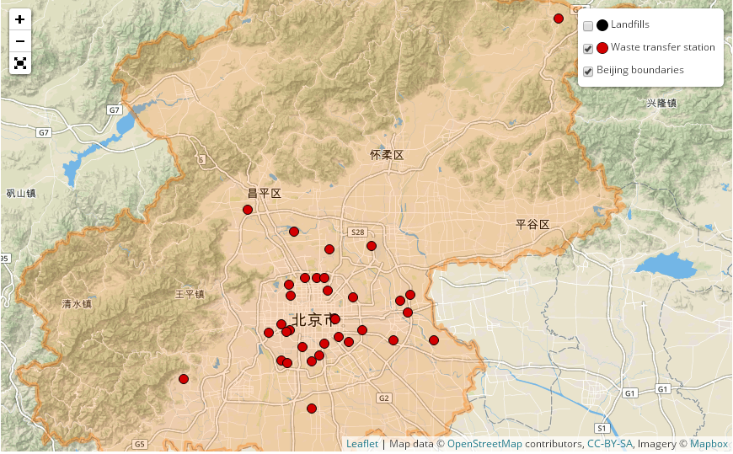
Waste transfer station
Source: Beijing Municipal Administration Committee and Baidu map
Notes:
Where they will be transferred

Slide 26
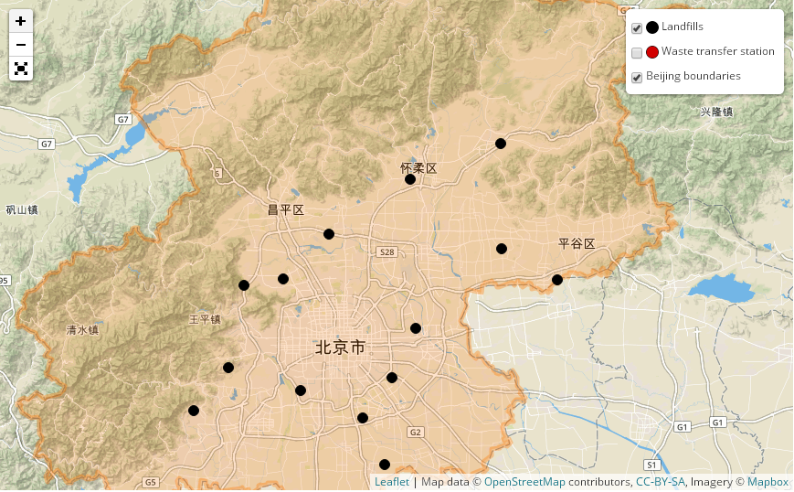
Waste treatment facilities
Source: Beijing Municipal Administration Committee and Baidu map
Notes:
To their final destination

Slide 27
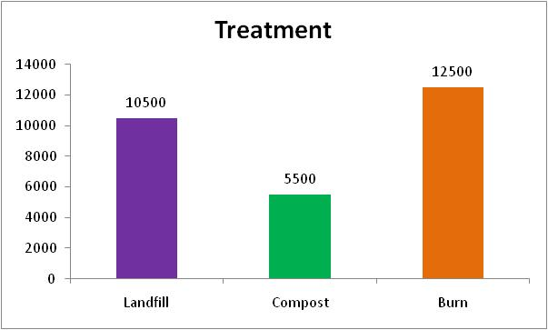
Waste treatment facilities
Unit: t/day
Source: Beijing Municipal Administration Committee and Baidu map
Notes:
And how they be treated by landfill? Compost? Or burn ?

Slide 28
Life cycle of waste
Generation
Drop-off
Transfer
Treatment
Recycle
Reuse

Slide 29
Any questions?
Any data?
Dr. Yupeng Liu (刘宇鹏)
Email: ypliu@iue.ac.cn
Phone & Wechat: +86-18511336671
Notes:
That is my presentation. Any question? It doesn't matter.
But any data

Slide 30
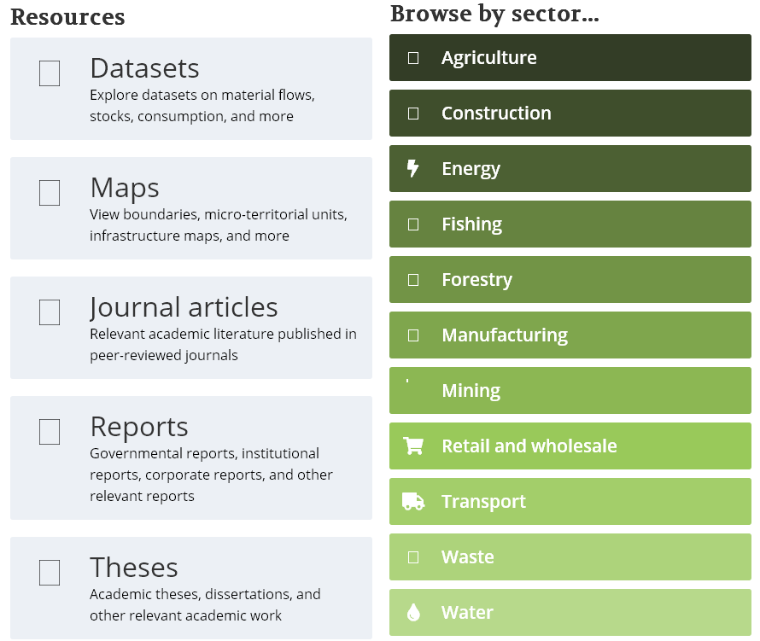
Notes:
Not just waste, any urban environmental, socioeconomic data
Even more knowledge from reports journal articles can share with us that would be great appreciate!

