Slide 1
Urban metabolism in policy and practice: a global discussion July. 6, 2019 Beijing
Community-based recycling program in Beijing
TONG, Xin
College of Urban and Environmental Sciences
Peking University in Beijing, China
Notes:
China has launched compulsory target for garbage sorting at source in urban residential communities since 2017. We present our research on two garbage sorting programs in Beijing and Shanghai.

Slide 2
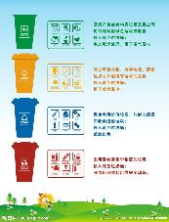
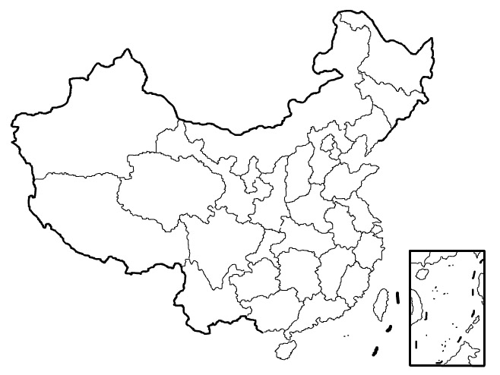
Urban waste management in transition
Compulsory garbage sorting led by Shanghai
Before 2017: NGO initiated program in Communities
After 2017: PPP contract with Enterprises
Shanghai
Separated Bins
+
Social mobilization
Notes:
The new business models tried to integrate the urban municipal solid waste management with the network of recyclables collection. Both the two programs adopted innovated internet-based solution to give incentives to the household to participate.

Slide 3
Emerging new business models
IT solution
Pure Internet platform
Automatic reverse vending machine
Community-based program
Driving force： Extended Producer Responsibility
Key elements:
Convenience： for consumers
Traceability： for producers
Profitability： for recyclers
Reliability： for public
Hybridity： for collection
Notes:
It has two parts. One is the

Slide 4
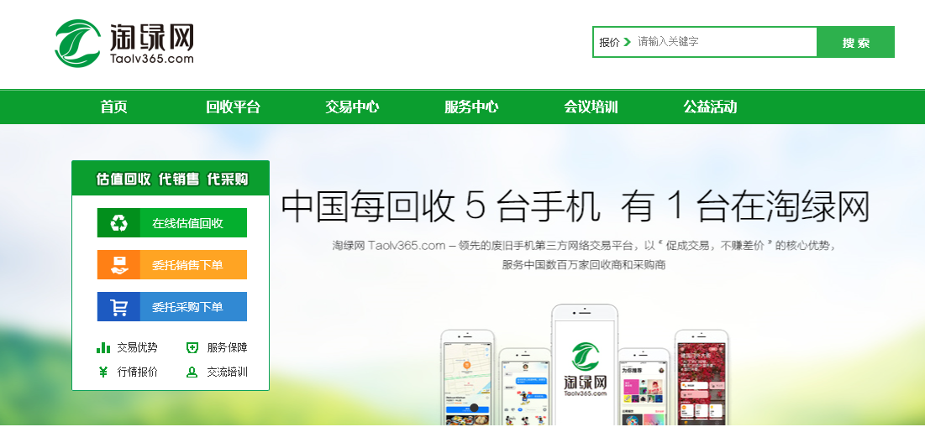
Model 1: Pure Internet Platform
Provide online trading platform to bridge the transactions between the consumers and recyclers.
B2B: Taolv365
C2B: Huishoubao

Slide 5
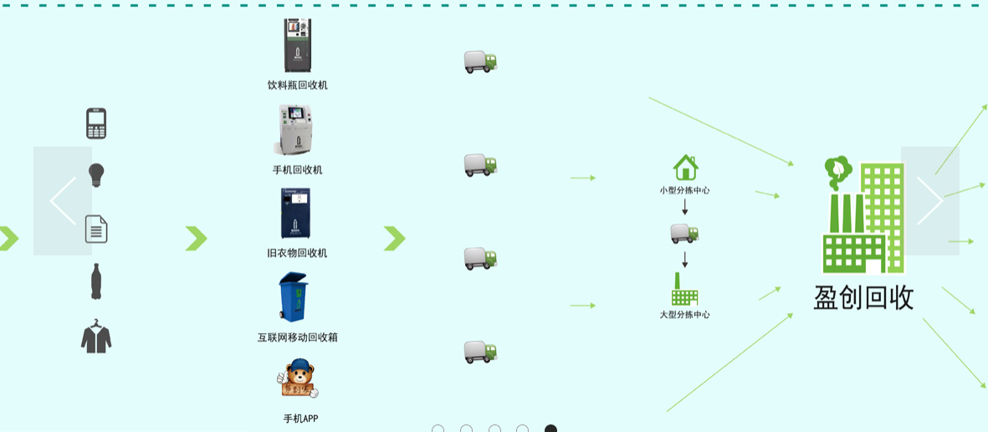
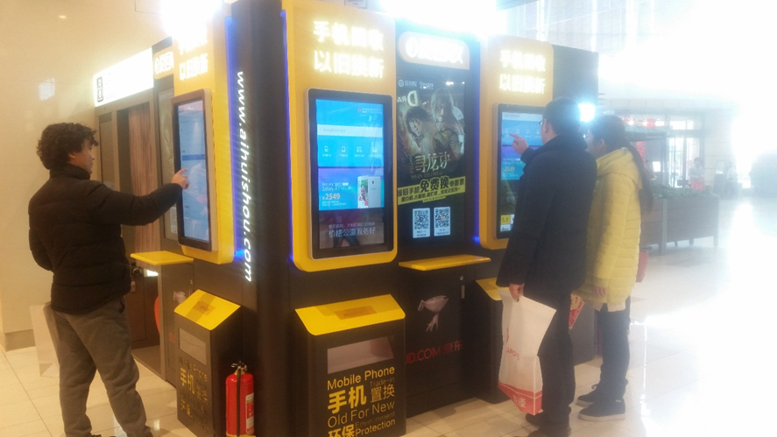
Model 2: Automatic Reverse Vending Machine
automatic vending machines that are attached to traditional commercial chains
C2B reverse logistics:
INCOM in Beijing
C2B bidding platform: Aihuishou in Shanghai

Slide 6
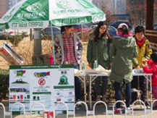
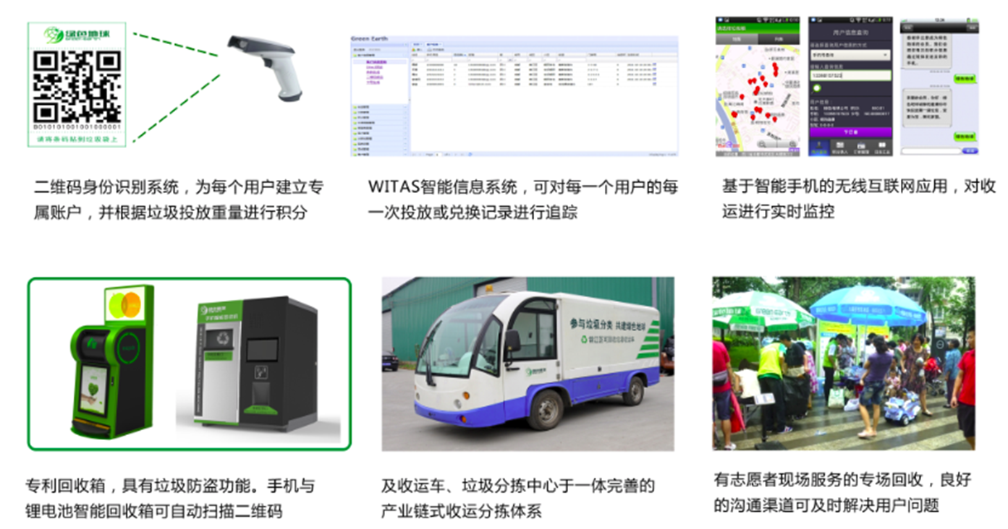
Model 3: Community-based recycling program
These models aim to collect discarded products from household directly, and combined with the promotion of garbage sorting in residential communities in cooperation with local government
Ala in Shanghai
Xiangjiaopi in Beijing
Huishouge in Wuhan
Sound in Xiamen
Green Earth in Chengdu
……
Notes:
All these business models share common characteristics by using the Internet technology, which are aggressively promoted in China as “Internet +” a vehicle for innovation and entrepreneurship by both government policies and venture capital investment. However, they are quite different in their strategy on the linkage between online and offline activities, which have significant impacts on their performance and replicability

Slide 7
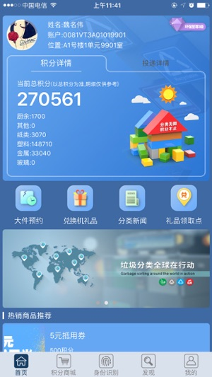
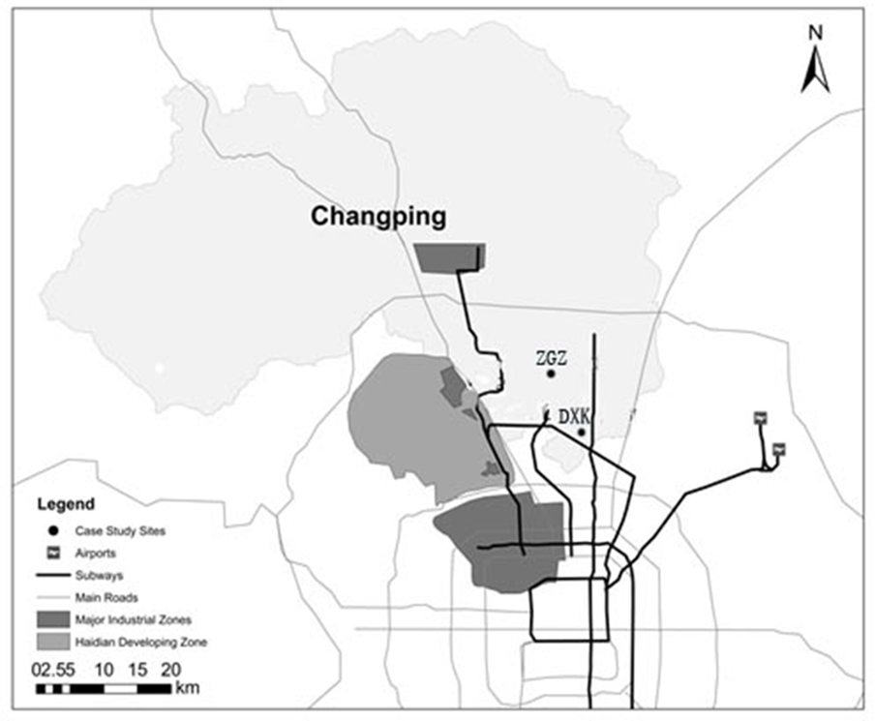
Ongoing project in Beijing
National Key R&D Program on Solid Wastes Recycling (2018YFC1902701 & 2018YFC1900101 ) (2018-2022)
Beijing
Shanghai
APP
+
Door-to-door collector
Notes:
The new business models tried to integrate the urban municipal solid waste management with the network of recyclables collection. Both the two programs adopted innovated internet-based solution to give incentives to the household to participate.

Slide 8
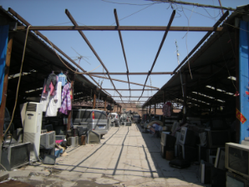
Starting point: Waste villages
Tong X, Tao DT. 2016. The rise and fall of a “waste city” in the construction of an “urban circular economic system”: The changing landscape of waste in Beijing. Resources, Conservation and Recycling, 107: 10-17.
Notes:
Beijing used to have hundreds of waste villages around the city sorting and trading recyclables.
The first one is Dongxiaokou. It was the largest waste village in suburb Beijing, booming during 2003 to 2008. By 2009, it had absorbed one quarter of the recyclable wastes generated by the city, with an annual value of transactions reaching 1 billion RMB (approximately 161 million USD). It provided an efficient and cheap solution for waste separation and recycling solution to the city. It also provided a feasible approach for the migrant workers entering the city. At its peak, it contained more than 1000 family workshops, with over 30,000 people working and living in it.
This village was demolished since 2011, arousing a public debate on how to deal with recycling for the city in future. Shall we have other waste villages just as usual? Or can we have alternative solutions?

Slide 9
Informal network between consumers and waste villages
discard
collect
process
Peddlar at residence
Household discard
Mobile Peddlers
Disassembler
Informal processing plant
50%
Refurbish
Recycle materials
discard
Material flow
Spatial segregation
Notes:
Because most of the end-of-life e-products go to the informal processing plants, which mainly locate in Southern China and rural areas surrounding Beijing. Driven by the profit in recycling precious metal in WEEE, they acquire the products with higher prices than the certified processing plants can offer, by reducing costs in other aspects, such as using unqualified processing techniques without environmental protecting measures, paying less to the workers, etc.

Slide 10
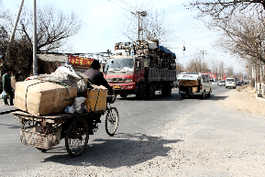
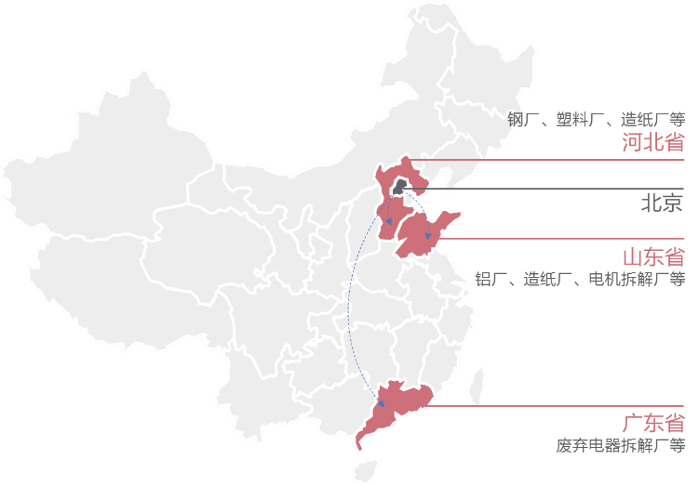
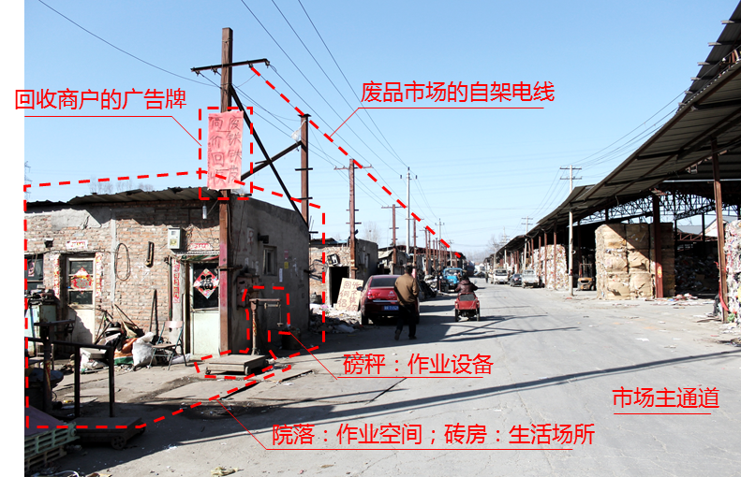
Informal network between waste villages and productions
Notes:
Garbage generated in the city was collected and sorted into materials, then being sent to the production site outside Beijing.

Slide 11
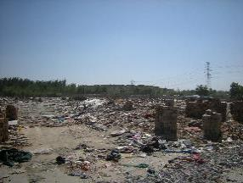
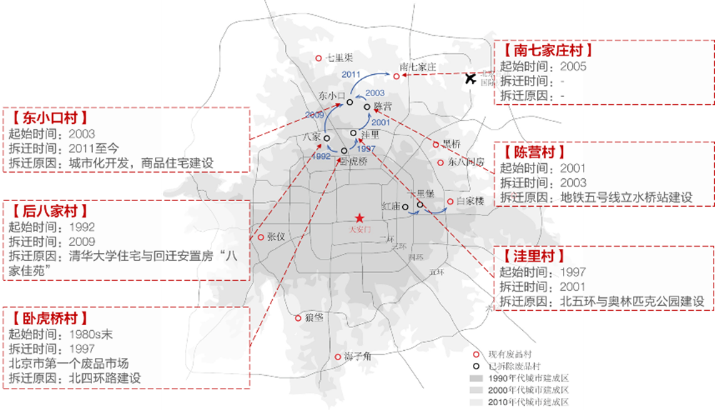
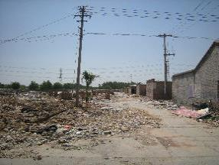
“Waste villages” being demolished
Notes:
From 2011 to 2015, the recycling markets in Dongxiaokou was demolished gradually. Some NGO tried to help the migrant recyclers to keep their living. But the resistance was not really effective.
But the demolition raised a public debate on how to deal with recycling for the city in future. Shall we have other waste villages just as usual? Or can we have alternative solutions?

Slide 12
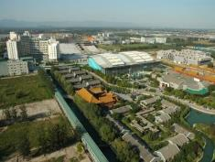
Participation observation in residential communities
2013.12
Initiated an experiment in ZGZ

Slide 13
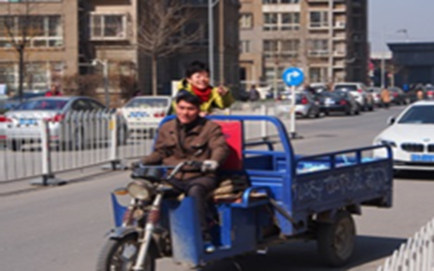
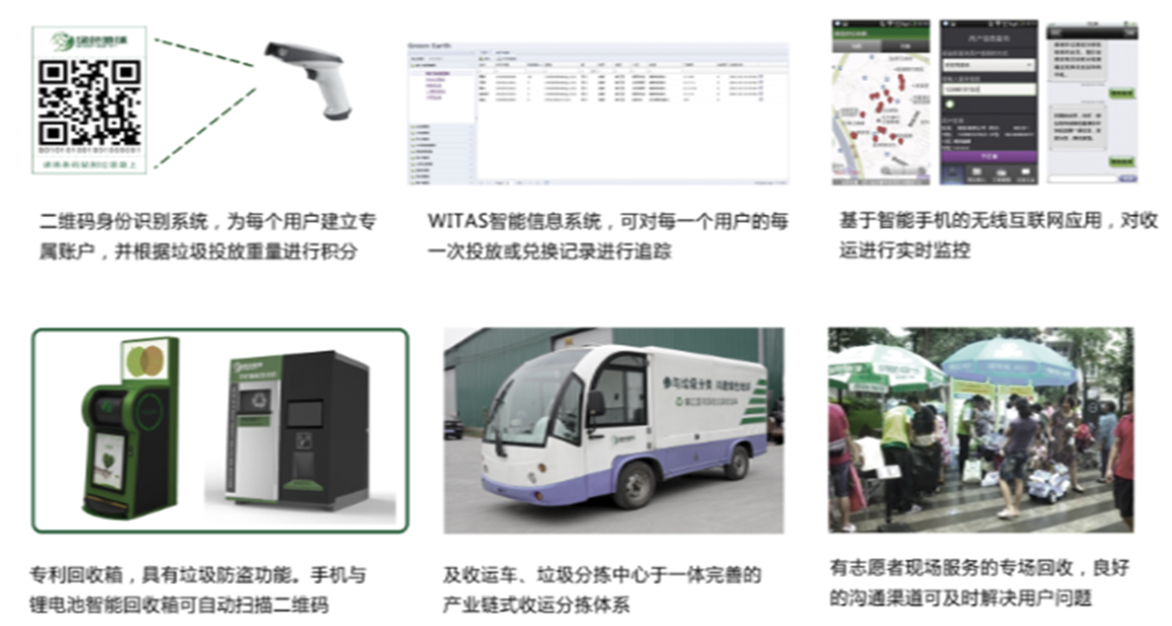
Participation observation in residential communities
Working with informal junk-buyer
2013.12
2014.7
2016.12
Initiated a community based recycling program
Termination of the experiment

Slide 14
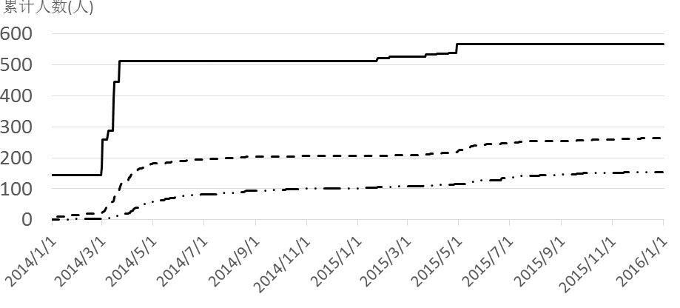
Participation of the households
Number of Households
Cumulative registered households
Households with discharges to our system
Households establishing sorting habits
Stage I
Stage II
Stage III
Notes:
This is the general result of the experiment. Roughly 40% of the registered households participated in the recycling program, among which, around 16% built the habit to use our system in waste separation.

Slide 15
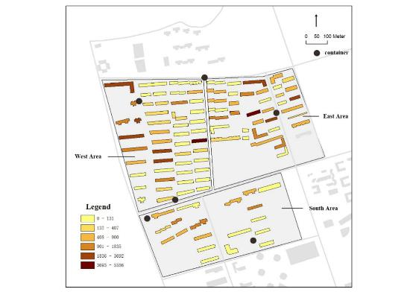
Various responses in different neighborhoods
Apartments sold to collective buyers from the same Danwei
Urbanized villagers
Apartments sold to independent buyers
Notes:
We find differentiated pattern of behavior in different neighborhood. The residential area can be divided into three part. The east part lives the local villagers. The west part are apartments collectively sold to employees of several big organizations, including a state-own company and two universities. So this two neighborhoods are both acquaintance societies with frequent social interactions. The southern area are apartments sold to independent buyers, thus is a stranger society with less social interactions.
The black dots are containers for recyclates. The darker the building, the more active the households living in that building in participation. So we can see that the distance from the container also affect the participation.

Slide 16
Diversified participation rates under different governance structure
 | Chengdu | Community in Beijing inner city | Z village 2014.4 | Z village 2015.5
Governance structure | PPP between municipal government and community recycling firm | Demonstration projects by municipal government and certified recyclers | Community recycling program initiated by Research team | community recycling program run by migrant junk-buyer
Registered Households / total households | 1397/3000 | 108/2250 | 512/10000 | 595/10000
Average discharge （kg/household/m） | 9.34 | 1.34 | 4.35 | 5
Participant rate | 50.5% | 27.8% | 37.9% | 15.6%
Sorting correct rate | 83.7% | 97.2% | 48.8% | 68.9%

Slide 17
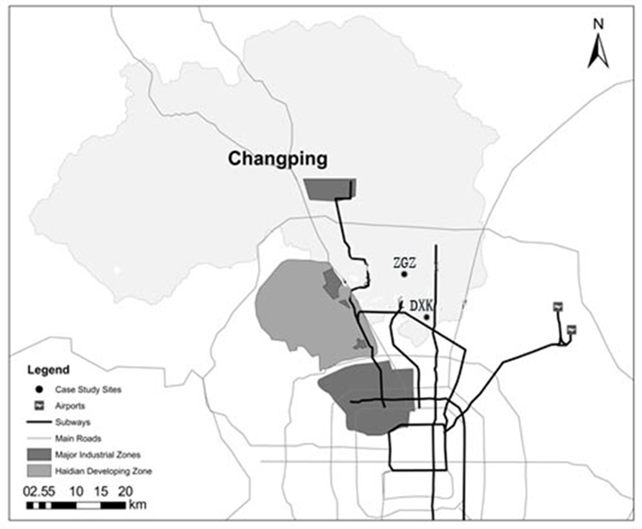
Participation observation in residential communities
PPP contract with Aifenlei
Working with informal junk-buyer
2013.12
2014.7
2016.12
2018.10
Initiated a community based recycling program
Termination of the experiment

Slide 18
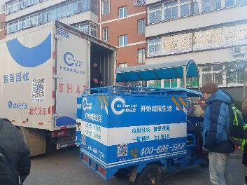
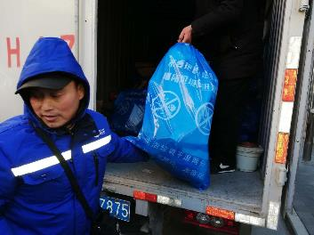
On call door-to-door collection

Slide 19
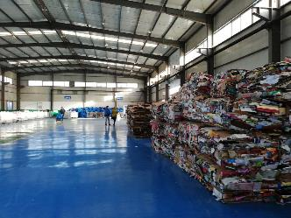
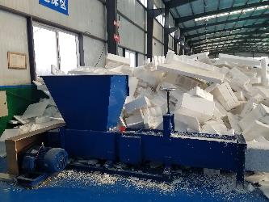
Sorting center

Slide 20
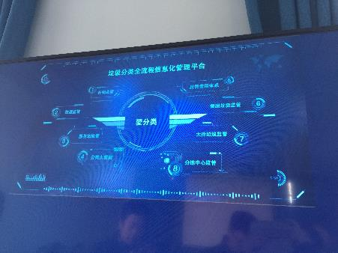
The use of Information Technology

Slide 21
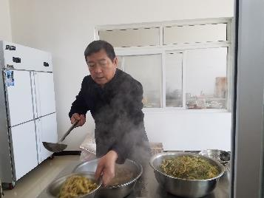
The transition across two generations

Slide 22
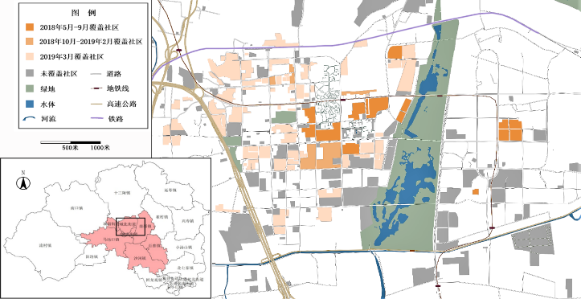
The service coverage of Aifenlei in Changping (till 2019.4)

Slide 23
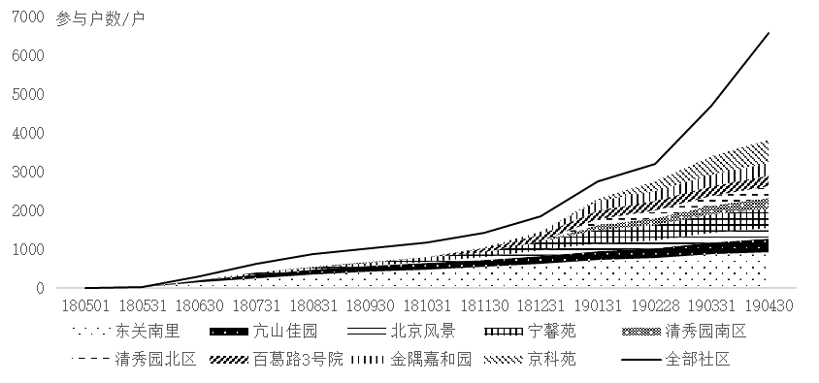
Overall participation

Slide 24
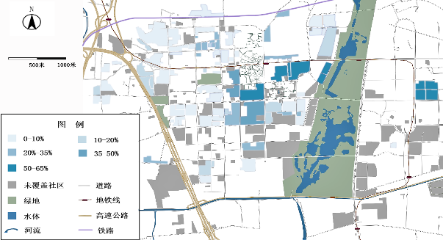
Diversified participation rate

Slide 25
Behavior change: a standard model
Social Norm
Attitude
Intention
behavior
Perceived behavior control

Slide 26
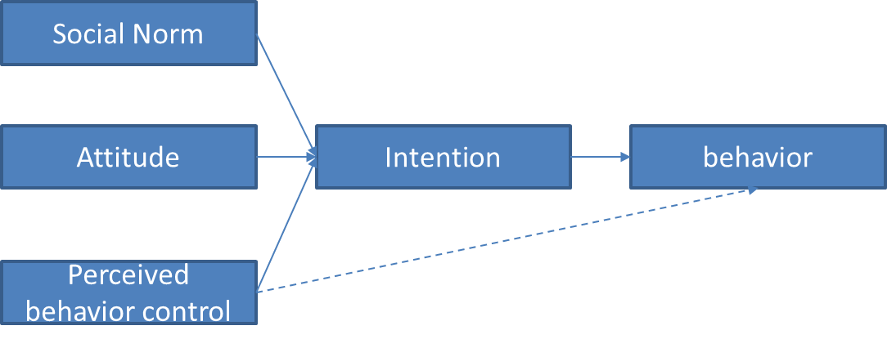
Behavior change: including the local factors
community level
Individual level

Slide 27
Reflections
From “macro” policy to “micro” policy
The behavior change are embedded in the diversified local institutions, which call for innovated micro policies
From “Observation” to “action”
Analysis tool for action-oriented research
Methods that can help scaling up local best practices while respecting the diversification of various local contexts

Slide 28
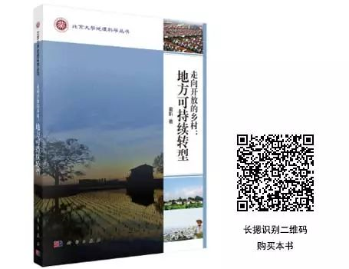
Thank you for attentions!
TONG, Xin
Associate Professor
College of Urban and Environmental Sciences
Peking University in Beijing, China
E-mail: tongxin@urban.pku.edu.cn
Office: 8610-62752835

