Slide 1
A glance of 20-year governance of the circular economy for Japan
Urban Metabolism in Policy and Practice: A Global Discussion @Beijing, 6 July, 2019
Qian Zhang
Department of Civil Engineering
University of Victoria, Canada

Slide 2
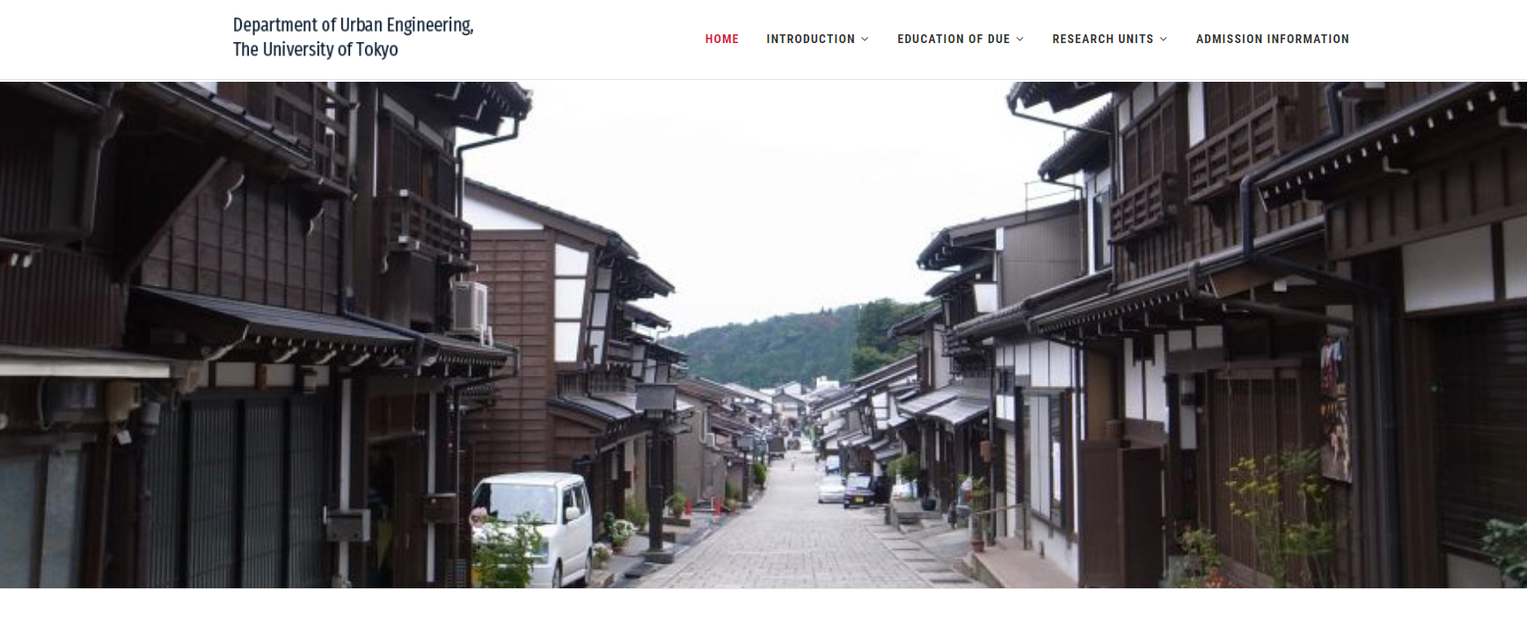
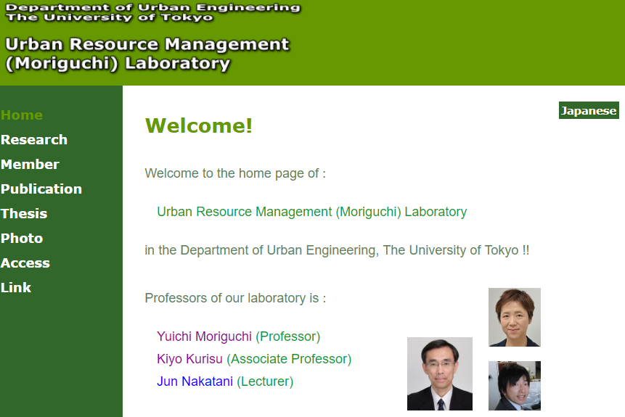
Self-Introduction

Slide 3
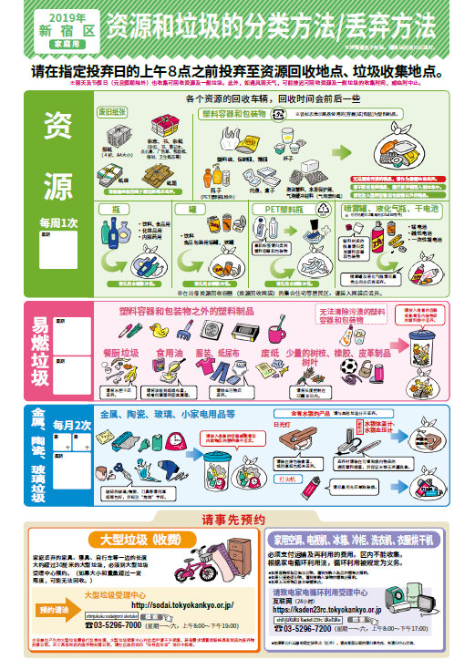
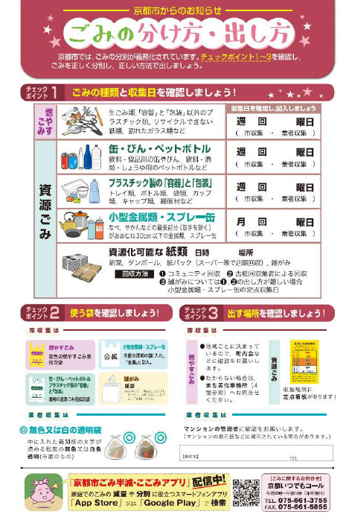
Japan: 47 prefectures have 47 ways of waste sorting and recycling!
Tokyo
Kyoto

Slide 4
Policy Background in Japan
Basic Act on Establishing a Sound Material-Cycle Society [循環型社会形成推進基本法] (2000): Preventing or reducing the generation of wastes from raw materials, products, etc.
Since 2003, Japan has introduced material-flow-analysis (MFA) based indicators in her fundamental plans [循環型社会形成推進基本計画] to monitor the progress in its national efforts for establishing a sound material-cycle society

Slide 5
Research Question: How Did Japan Come Through the Challenges of Waste Management?
Contextual analysis of the Fundamental Plans for the CE
Governance indicator compilation from the perspective of MFA

Slide 6
Fundamental Plans
Basic Act
(Law)
1st Fundamental Plan for 2010
2nd Fundamental Plan for 2015
3rd Fundamental Plan for 2020
4th Fundamental Plan for 2025
2000
2003
2008
2013
2018
3R policy
of the state
Waste
management
EPR
Waste
management
Low-carbon
Resource
security
2R promotion
Economic vitality
Disaster response
SDGs
Note:
3R: Reduce, Reuse, Recycle; EPR: Extended Producer Responsibility; 2R: Reduce, Reuse;
SDGs: Sustainable Development Goals

Slide 7
The First Fundamental Plan (2003)
Based on the Basic Act, recommended measures for waste management are: Reduce > Reuse > Recycle > Heat Recovery > Final disposal
Indicator design: Inflows, Cyclic flows, Outflows
Construction wastes & Industrial wastes
Partnership: the government, consumers, NGO/NPO, practitioners, local communities

Slide 8
The Second Fundamental Plan (2008)
Construction materials separately considered
GHG emission targets
International comparison
Survey to monitor consumers’ behaviors
Waste reduction: per capita waste generation -10%/10y
Circular business models

Slide 9
The Third Fundamental Plan (2013)
Regulations achievement: E-waste recycling, bicycle recycling, package materials recycling, food waste reuse
Reduce & Reuse strategy: food loss, long life-time products promotion, environmental education
Disaster waste treatment capacity
Final disposal sites & Waste export
Hazardous wastes

Slide 10
The Fourth Fundamental Plan (2018)
Societal transition: Regional Circular and Ecological Sphere
Life-cycle resource circulation (consumption-based): SDGs
Basic Act on Promotion of Consumer Education [消費者教育の推進に関する法律] (2012): Responsible Consumer Civil Society
Disaster waste treatment systems
ICT & IoT application, information sharing
International waste regulation & business opportunities

Slide 11
Governance Indicator Framework
(Economy-Wide) Material flow indicators | Monitor the material flow to identify and stimulate the transition in the Japanese economy Targets on Resource productivity, Cyclical use rate and Final disposal amount representing the three aspects of material flows, namely inflows, cyclic flows and outflows
Thematic material flow indicators | Monitor the improvement on the material flow of specific targets/stakeholders
Thematic management indicators | Monitor the effort/action itself of the each stakeholders

Slide 12
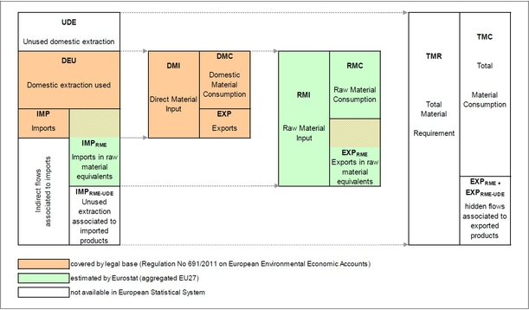
Economy-wide Material Flow Indicators

Slide 13
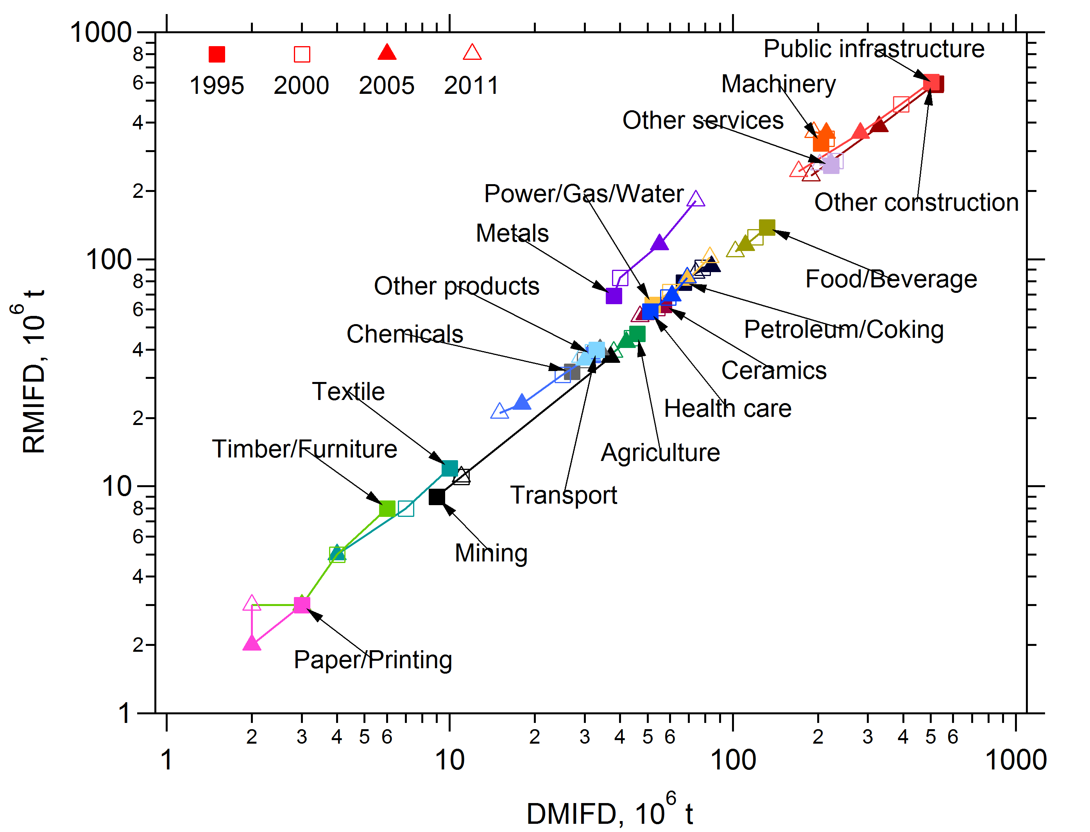
Historical Change in Material Input of Japan

Slide 14
The MFA of Japan

Slide 15
Targets in the 4th Fundamental Plan
Task | Resource productivity | Cyclical use rate | Recycling rate | Final disposal
 | GDP/DMI | Cyclical use / (cyclical use + DMI) | Cyclical use / generated waste | Landfill disposal of waste
2025 | 490K yen / t | 18% | 47% | 13 Mt

Slide 16
Denominator, input
Denominator, input
Resource Efficiency = Output value / Resource use | Direct use | Indirect use included | Mid-point impacts of resource use | End-point impacts of resource use
Monetary output as a proxy | GDP / DMI, GDP / DMC | GDP / RMC, GDP / TMR | GDP / GHG from fossil fuels | GDP / Integrated impact
Functional or physical output | 1 / MIPS¹, MFCA² | Energy / Virtual water | Floor area / Tensile strength
Multi-functional values by weighting factors | Quality of life (QoL) / Land | Customer satisfaction / Utility costs³
Function values in multiple processes | Function attribution / Material input |  |  | Coverage of RE Indicators
Numerator, output
Numerator, output
¹MIPS: Material input per unit of service; ²Material flow cost accounting; ³developed by Toshiba for home appliances

Slide 17
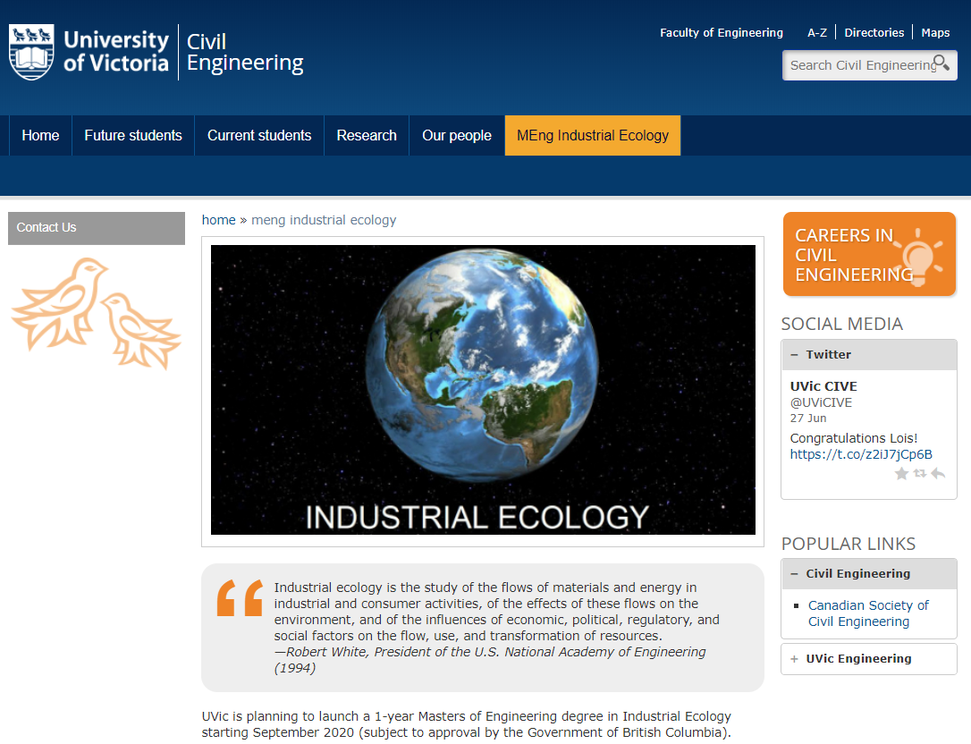
Industrial Ecology Master’s Program in UVic
uvic.ca/civil/IE
Thank you for your attention! Qian Zhang: zhangqian@uvic.ca

