Slide 1


Policy Interventions to
Advance Sustainable Materials Management:
A Socioeconomic Discussion in the U.S. Context
Ning Ai, Ph.D. 艾宁
Dept. of Urban Planning and Policy
Inst. for Environmental Science and Policy
University of Illinois at Chicago
Seminar on Urban Metabolism in Policy and Practice, Beijing, China, July 6, 2019

Slide 2
Research Motivation
2
  Standalone processes of environmental and socioeconomic aspects of materials and waste management (MWM)
  Challenges of financial viability and sustainability
  Dilemma of social equity vs. economic efficiency
  Lack of MWM data to support locally specific and efficient strategies

Slide 3
Integrated MWM Approaches

Slide 4
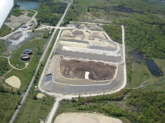
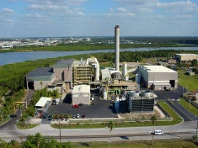
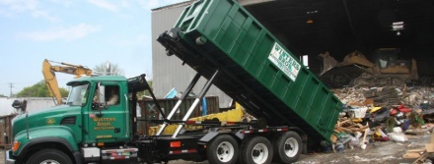
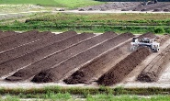
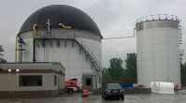
General Flows of Municipal Solid Waste (MSW)
Ai, Ning. 2011. "Challenges of Sustainable Urban Planning: The Case of Municipal Solid Waste Management." Doctoral Dissertation, Georgia Tech.

Slide 5
Improve the MWM Efficiency by Strategic Infrastructure Planning
Integrated Infrastructure Planning
Consider MWM in New Development
Minimize Impacts of Existing Facilities
Monitor existing use and capacity
Expand MRF, C&D, and WTE capabilities
Explore new MWM methods and techniques
Recover methane from closed landfills
Avoid Unnecessary Expansion
Encourage source reduction and separation, recycling, reuse and composting
Incorporate reduction, diversion, and conversion in capacity projections
Require a county-wide review before siting new landfills
Mitigate Impacts of New Facilities
Preserve industrial lands
Only site new landfills in Candidate Solid Waste Landfill overlay
Design access routes to minimize traffic impacts
Screen landfills with vegetation
Plan for eventual restoration
Increase public awareness of solid waste issues
Summary from Envision San José 2040: General Plan, Adopted November 1, 2011
Ai and Leigh (2017) Adapted from Daniels, 2014, p. 238.

Slide 6

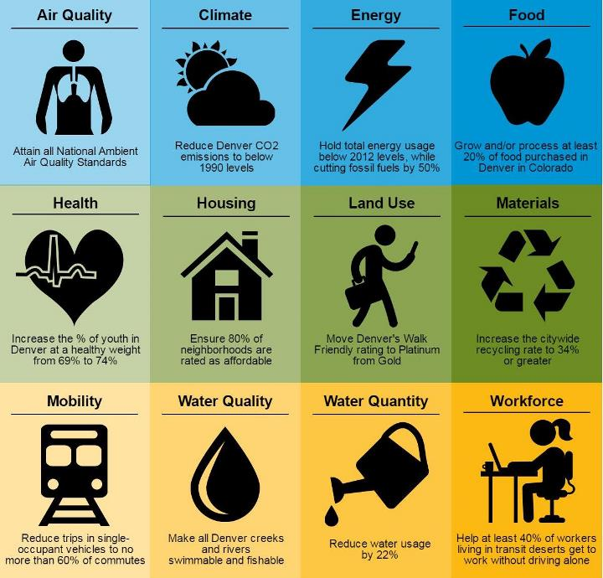
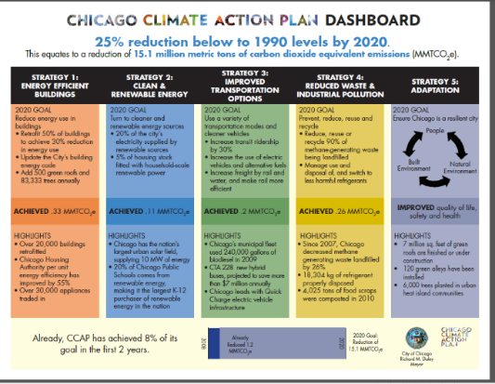
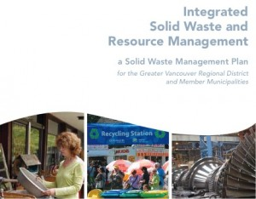
Connecting MWM Plans with Other Regional Plans
Source: Metro Vancouver (2010).
Notes:
https://www.denvergov.org/content/dam/denvergov/Portals/779/images/2020%20Goals%20Infographic%20082916_cropped.jpeg

Slide 7
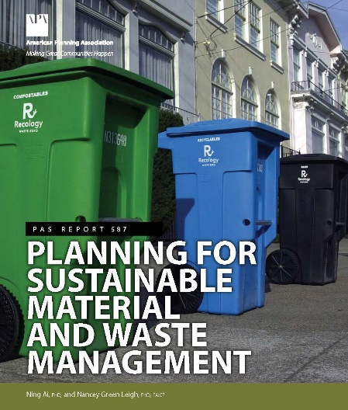
Environment
  Compliance and progressive zero waste plans
  Determine locally specific MWM methods
  Plan across environmental media
  Connections with other sustainability plans
Infrastructure
  Incorporate MWM considerations in new development reviews
  Decouple waste volume from economic and population growth
  Integrate material and waste management infrastructure
  Plan for MWM infrastructure that integrates green design and environmental health impacts through life cycle stages of MWM
Finance
  Budget planning for MWM services
  Account for full costs when pricing for waste services
  Dedicate MWM revenue to support recycling programs
  Balance environmental and economic goals
Sustainable MWM
Planning
Strategies
Economy
  Job creation through reuse, recycling, and remanufacturing (R3) activities
  R3 industry development
  Planning and policy tools for economic development from waste diversion
  R3 requirements for business and consumers
Equity
  Controversy surrounding waste facility siting
  Market drivers and confounding factors that challenge equity goals
  Stakeholder involvement, zoning ordinance, and assistance programs towards equity goals
Technology
  Data barriers to efficient and effective MWM
  Plan for community-specific MWM using smart MWM technology
  Employ planning tools that facilitate MWM data collection
Ai and Leigh (2017)

Slide 8
Balancing Environmental and Socioeconomic Goals

Slide 9
Life Cycle Cost of MWM
9
Full cost accounting/life cycle cost: 50-year span
Three-step analysis
Findings
    Pro-landfilling activities incur the lowest short-term cost, but experience cost jump in the long run due to recurring and after-closure maintenance.
    Short-term cost considerations discourage recycling.
Prior Construction
Construction
Operating
Maintenance
Closure
Post-Closure
Indirect Impacts
Externality costs
Multiplier effects
Long-Term
Direct Impact
Facility maintenance
Monitoring and impact assessment
Short-Term
Direct Impact
Waste collection
Waste transportation
Waste processing
Post-closure care
Ning Ai. “Implications of Sustainable Solid Waste Management for Metropolitan Planning.” The 50th ACSP Annual Conference, Crystal City, VA, October 1-4, 2009
Notes:
In a system view of each waste management option, this study adopted a full cost accounting approach, which aimed to include all the costs associated with providing a particular waste management service throughout the production process (National Recycling Coalition, 1996). For instance, the costs for landfilling include pre-construction costs, construction costs, operating, maintenance, closure and post-closure care, as well as social and environmental impacts. This study also took into account the “multiplier effects” created through inter-sectoral linkages. The indicator of “value added” included in the analysis, in particular, measures the demand of goods and services for waste management activities from other sectors (Goldman and Ogishi, 2001). To incorporate the concerns about externalities, this study also considered environmental damage costs of waste disposal.
To incorporate the cost considerations discussed above, this study developed a three-step analysis (illustrated in Figure 5.1). The first step only focused on the short-term costs, or one-time direct costs, such as waste collection cost, waste transportation cost, and waste processing cost, which are the most visible and straightforward costs of waste management activities. Specifically, short-term analysis is limited to a study period of 20 years, which is approximately the average landfill capacity. The next step included the costs along the entire life cycle of waste management operations. Besides the cost items included in Step 1, Step 2 included costs that occur after the waste is disposed, such as landfill maintenance and post-closure care. To investigate the interaction of short-term and long-term costs, the cumulative net present cost of year i (1≤i≤50) for managing one ton of waste at year 1 is calculated at an assumed discount rate of 3.5%. The third step further included indirect impacts, such as multiplier effects and externality costs.
Because of regional variations in waste management operations, a cost-effective analysis has to be region specific. California is chosen to be the context of this simulation study because the state is one of the most advanced in waste management and has progressively enacted legislation to promote waste reduction and diversion from landfills.

Slide 10


MWM Approaches during Economic Recession
10
  Increase fees
  Reduce services
  Privatize services
  Improve efficiency
  Control waste flow
  Promote recycling, reuse, and recovery
Reduced MWM budget does not necessarily compromise environmental performance.
Ai, Ning, and Anthony Grande. 2012. “Financially-Viable Approaches to Municipal Solid Waste Management during Economic Recession.” Young Professional Best Paper, 105th Annual Conference and Exhibition of the Air and Waste Management Association, San Antonio, Texas, June 19–22.

Slide 11
Market Based Instruments for MWM
11
REVENUE-GENERATING INSTRUMENTS | COST-INCURRING INSTRUMENTS | NON-REVENUE INSTRUMENTS
– Variable unit pricing | – Subsidies | – Tradable pollution rights
– Waste flow controls* | – Tax credits for green businesses | – Liability for environmental damage
– Green taxes (eco-taxes) on consumption and production (e.g. plastic bag fees, tax on the use of hazardous substances in products) | – Host community compensations for facility siting | – Public procurement requirements (e.g. goods with specified percentage of recycled materials)
– Taxes on disposal options (e.g., landfilling, incineration) | – Grants (e.g. for research and recycling programs) | – Deposit-refund systems (e.g. for beverage containers)
 | – Rewards for recycling | – Extended producer responsibility (EPR)
Ai, N. and Leigh, N. L. (2017) Planning for Sustainable Material and Waste Management. American Planning Association (APA) Planning Advisory Service Report.
Adapted from UNEP (2015), Box 4.17 and the IDB report by Cointreau and Hornig (2003). *Waste flow controls have been proposed by several regions but are currently prohibited by the federal law.

Slide 12
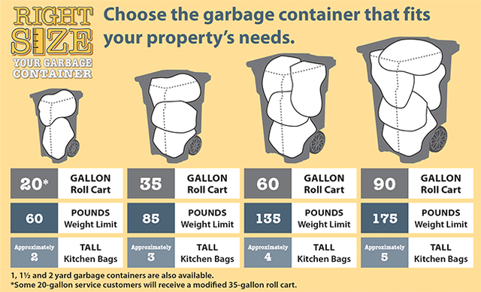

Economic and Market Approaches
12
  Extended product responsibility (EPR): Companies take back used items and manufacture more durable goods
  Full cost accounting
Pay as You Throw (PAYT)
Recycling Reward Programs
Source: City of Portland.
Source: http://www.go-green.ae/uploads/rewardsa.jpg

Slide 13

Impact of Reduced Garbage Collection on Diversion
13
Images: City of Portland.

Slide 14
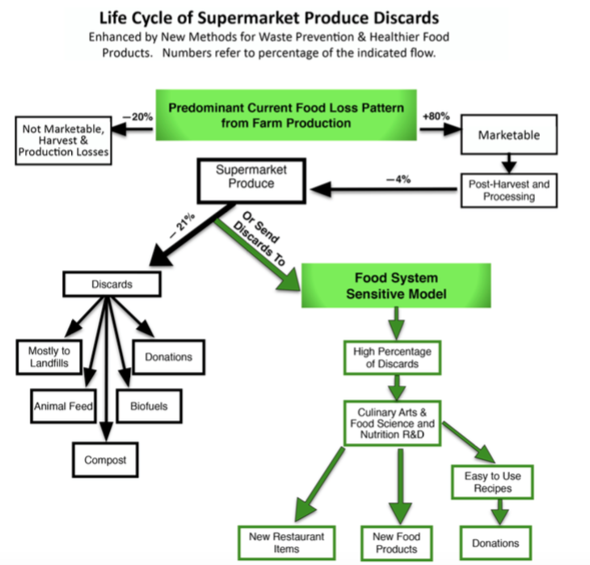
Urban Model for Surplus Food Recovery
(West Philadelphia)
Value Added Approach
14
(O’Donnell 2015)

Slide 15
Confounding Factors of Equity in MWM

Slide 16
Waste Management: Burden or Wealth
16
“[New York] city’s waste was a fair exchange for the city’s cultural and economic contributions to national life” - Former Mayor Rudy Giuliani (quoted from Gandy, 2002)
“Landfills and communities can work together and accept each other and actually benefit from each other” - A former official of the Illinois Environmental Protection Agency (quoted by Parker, 2003)
“Garbage is good” (quoted by Parker, 2003)
Interstate waste movement, 2003 (Repa 2005)
Gandy, M. (2002).Concrete and Clay: Reworking Nature in New York City, Cambridge: MIT Press.
Parker, B. (2003).White Paper: Solid Waste Landfills and Residential Property Values. National Solid Wastes Management Association (NSWMA).

Slide 17
Claimed Benefits of Waste Import
17
Host community fees
Tax revenues
New job opportunities
Free or low-cost waste disposal quota
Portion of energy recovery
Infrastructure improvement
Source: Parker, B. (2003). White Paper: Solid Waste Landfills and Residential Property Values. Online publication of National Solid Wastes Management Association (NSWMA).
Picture source: http://www.abatement.com/images/airduct/profits.jpg

Slide 18
Planning Tool: Zoning Ordinance
18
Example zoning ordinance showing zoning districts in which MWM facilities are permitted (Sacramento County CA 2017)

Slide 19
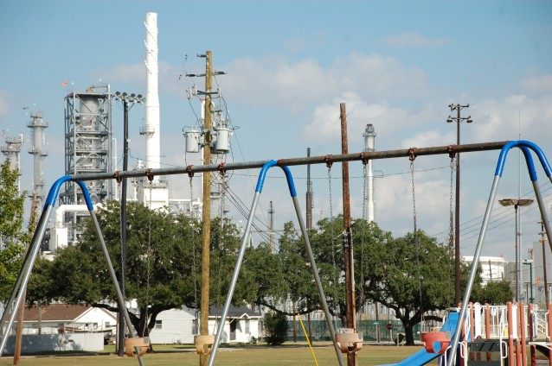
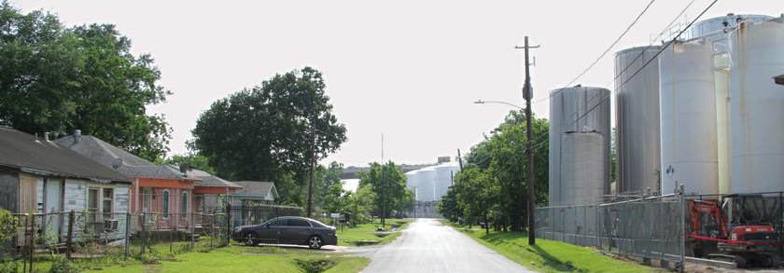
Chicken or the Egg?
19
Valero Refinery: Manchester (Houston, Texas)
More information available in the Fact Sheet by Texas Environmental Justice Advocacy Services.
https://www.ucsusa.org/center-science-and-democracy/connecting-scientists-and-communities/air-toxics-and-health
Notes:
On the east side of Houston, Texas, nestled between one of the busiest highways in the city, the freight shipping ports of the ship channel, and 26 lanes of Union Pacific railroad, sits the community of Manchester.1 Its residents—98 percent minority and 65 percent low-income—have borne the brunt of Houston’s growth in commercial industry. Nineteen industrial facilities dot the small community, including oil refineries, chemical and fertilizer facilities, and metal recycling plants; several more are located in close proximity to Manchester. The only public green space, Hartman Park, sits next to the Valero refinery.
Demographics: The Manchester community has a population of 5,745 with 2,221 people per square mile. About 95% of the population is Hispanic; the other 5% is white alone and black alone. The median household income in 2013, was $34,098. About 46.5% of the population has less than a high school education, 6% have a high school diploma, 14.7% have some college, and 4.9% have a bachelor’s degree. (information gathered from city-data.com)
The refinery is located within 20 feet of some resident’s yards.

Slide 20
Local and Material-Specific Resource Management

Slide 21
Need of Community-Specific Data
21
Comparison of residential MSW composition
Comparison of top-ten landfill-bound residential waste composition by income group
Source: Illinois Recycling Association 2015, Fig 2-15
Data source Chicago Department of Environment 2010)

Slide 22
Planning Tools that Facilitate MWM Data Collection
22
Web-based tools for MWM data analysis, information sharing, and policy development
Technology supported tracking systems (e.g., RFID)
City ordinances that incorporate recycling and data reporting
Market derived data (e.g. Pay as You Throw programs)
Stakeholder involvement

Slide 23
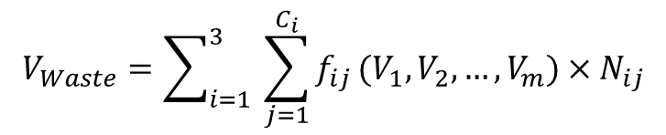
Case Illustration I:
Chicago Food Waste Volume Estimates
23
$$V_{Waste}=\sum_{i=1}^{3}{ }\sum_{j=1}^{C_{i}}{f_{ij}}(V_{1},V_{2},…,V_{m})×N_{ij}$$
V_{waste}: Food waste generation (by weight);
i: Generator type (i=1 Residential; i=2 Commercial; i=3 Institutional);
j: Sub-categories of each generator type, such as SF and MF of residential generators (detail categories in Table 1);
C_{i}: Number of sub-categories of generator type i;
f_{ij} (): Food waste generation rate for sub-category j of generator type i;
N_{ij}: Number of units (e.g., employees or establishments) in sub-category j of category i;
V₁ , V₂, …, V_{m}: causal factors of food waste generation;
Ning Ai and Junjun Zheng (2019）
Notes:
To fill the data gap, we have developed a Generic model.
inclusive and bottom-up approaches to food waste reduction, reuse, and recovery at the neighborhood level.
All data inputs can be publicly accessible.
The generic model quantifies food waste generation (supply) from mixed categories of land uses and can be adapted in a specific neighborhood.
Here shows an example of our results, estimates at the zip code level for annual generation volume.
For a conservative estimate, City of Chicago generates over 430,000 metric tons, of food scraps each year from residents, businesses, and institutions.
At zip code level, each zip code generates from 600 to 15,000 tons each year.
Causal factors – temporal factor,
city of Chicago has the potential to donate at least 12,900 tons of FW annually to feed hungry people, as of 3% of total FW generation.
Within the city limits there are close to 60 different Chicago zip codes. Typically, a single zip code will stretch across several separate Chicago neighborhoods. However, there are many neighborhoods big enough to have their own zip code, such as East Rogers Park (60626). You'll also find quite a few Chicago neighborhoods that are divided by more than one zip code, like Lawndale which is spread out over five zip codes. And the Loop, despite its small size, requires six zip codes all to itself because of the high concentration of addresses in downtown.

Slide 24
Chicago Food Waste Study:
Connecting Local Supply and Demand
24
Ning Ai and Junjun Zheng (2019）
Notes:
Clearly the locations with a high density of recoverable food do not match the
demand of food donation, e.g., food banks (illustrated as small yellow dots).
To identify the communities that either have high donation potential or desire more
supply at the food banks, this study developed a food waste Supply-Demand Index
(SDI), which is calculated as the difference between the Food Supply Index and the
Food Demand Index. The Food Supply Index is calculated by the percentile value (0 to
1) of food donation potential density in a given community. The Food Demand Index is
calculated by the percentile value of food bank density in a given community. If the SDI
is larger than 0.25, we assumed that food discard volume was higher than the demand
from food banks and the area is categorized as the “Surplus”. If the SDI is lower than -
0.25, we assumed that the area needs more food donations and thus categorized it as the

Slide 25
Transforming Urban Challenges into Opportunities:
Close the Loop of Food Waste
25
Ning Ai. “Modeling Food Waste for Neighborhood-Based Sustainable Practice.” The International Society for Industrial Ecology Conference, Surrey, UK, July 7-10, 2015.
Notes:
Many would attribute the inefficiency in food waste recovery to the unique challenges, which can be highlighted in urban areas.
small amounts of FW are generated from a large number of locations, but generally left out of the current FW recycling process.
Ordor, water content, and time-sensitivity also contribute to transportation complexities.
How to justify the cost?
urban areas presents potential opportunities of economies of scale in food scrap collection and thus leads to cost savings.
Meanwhile, urban areas with extensive and diverse businesses (e.g., restaurants, shops, medical centers, universities) have significant potentials for alternative strategies.
Recovering, recirculating, and reusing food discards further create job opportunities and foster community engagement
Rather than the food logistics challenge, it is the data limitations – quantity, quality, distribution,
In particular food donation, which we have focused on
alternative FWM strategies, such as source reduction, donations to food pantries, use for animal feed or industrial feedstock, and composting
How to get there? Quantity, quality, spatial distribution.

Slide 26

Case Illustration II:
EV Batteries
26
Short lifespan
Significant mass and volume
Substantial component of lithium
Difficulty in disassembly
Limited data availability
Specific infrastructure needs
  Recycling/Disassembly
  Remanufacturing
  Repurposing (e.g. energy storage)
Notes:
The U.S. markets for reusing and recycling post-vehicle EV batteries are still under development, despite the rapid growth in EV sales.
Only a small proportion of used batteries have been recycled domestically and supporting facilities are still lagging (Wang et al., 2014a).

Slide 27
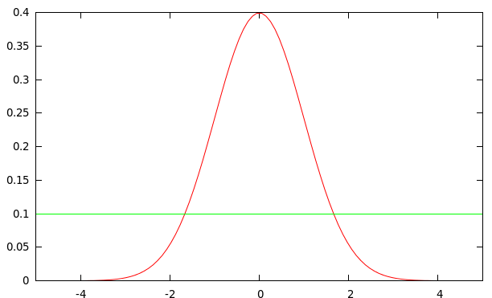
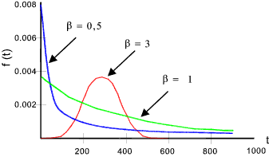
Key Parameters of EOL EV Battery Estimates
27
Lifespans
  Constant Lifespan Scenario: All EV batteries retire between 3 and 8 years with an average lifespan of 5.5 years.
  Dynamic Lifespan Scenario: Technology advancements prolong the in-vehicle battery lifespans. The average life expectancy increases from 5.5 years (in 2010) to 9.5 years (in 2020), and to 12 years (in 2030).
Discard patterns
  Uniform distribution of discard rates.
  Truncated normal distribution function.
  Weibull distribution function.
Uniform Distribution and Normal Distribution
Weibull Distribution
Source: http://i.stack.imgur.com/ http://www.roymech.co.uk/Useful_Tables/ARM/Failure_Distributions.html

Slide 28
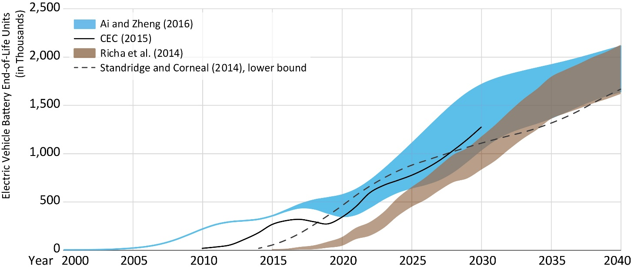
U.S. Annual EOL EV Battery Volume
28

Slide 29
Case Illustration in California
29
  On an annual basis, 52% of new EVs in the U.S. were sold in CA
    33,200 PHEVs and 40,300 BEVs sold in 2016 (3.5% of new vehicle sales)
    California Zero Emission Vehicles (ZEV) Plan: target a 15.4% market share of ZEVs of new car sales by 2024; 100% of market share by 2050
    Urgency of managing EOL EV batteries
  Progressive adoption of renewable energy
    Documented need for energy storage systems to ensure the reliability of the grid, to better utilize the existing renewable capacity, to reduce the consumption of fossil fuel, and to mitigate climate change impacts.
Notes:
On an annual basis, 52% of new EVs in the U.S. were sold in the State of California.¹⁶⁻¹⁷ In 2016, the state sold 33,200 PHEVs and 40,300 BEVs, which together account for 3.5% of new vehicle sales (i.e., New Light Vehicles Sales at 2.09 million).¹⁸ The California Zero Emission Vehicles (ZEV) plan targets are to have ZEVs account for 15.4% of new car sales by 2024.¹⁷ Eventually, the ambitious plan projects that ZEVs would reach 100% of market share in California by 2050.¹⁷ The rapid growth of the California EV market and its anticipated full market penetration demonstrate the urgency of managing EOL EV batteries.
Just a quick note on formatting. The guideline has no indent for paragraphs, and there is a double space between paragraphs.

Slide 30
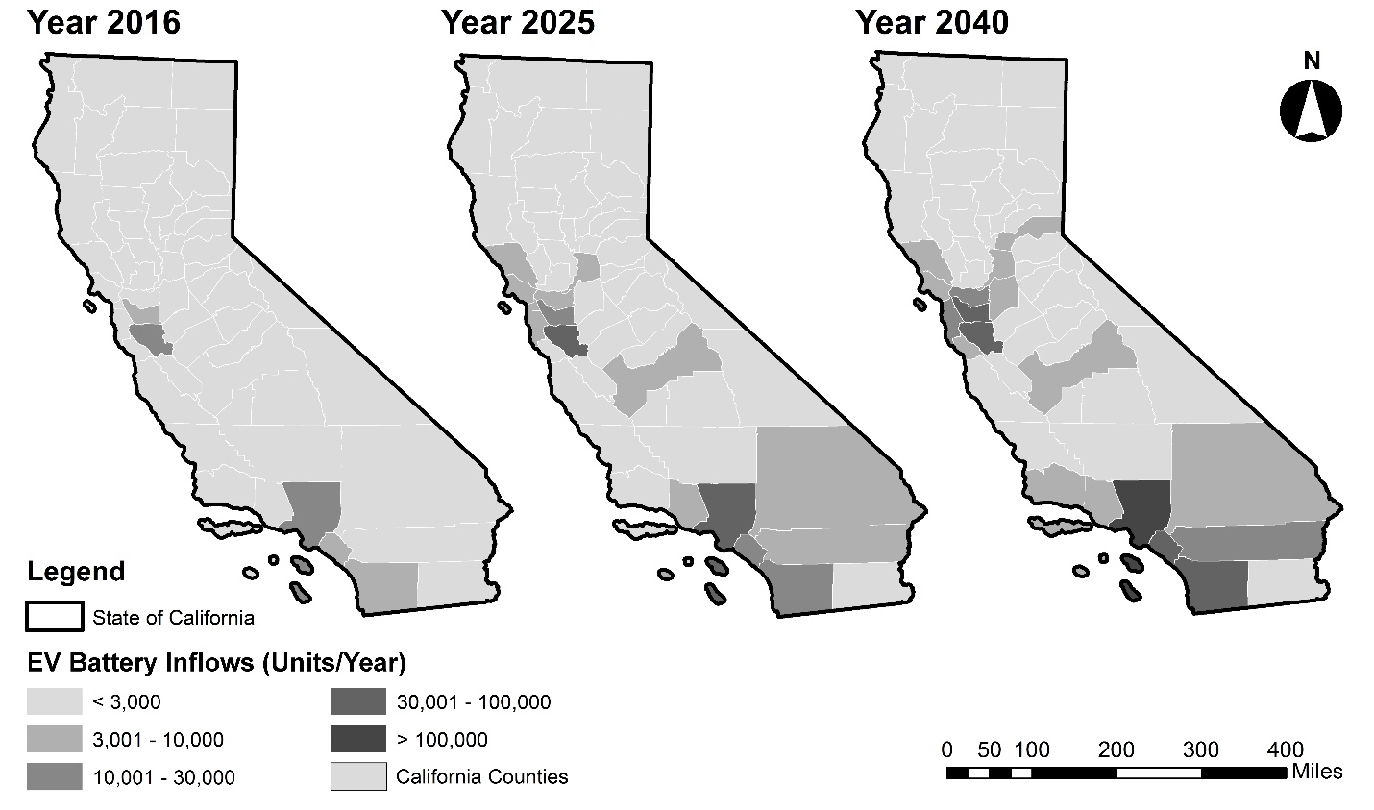
Annual EV Sales by County
30
Ning Ai, Junjun Zheng, and Weiqiang Chen (2019)

Slide 31
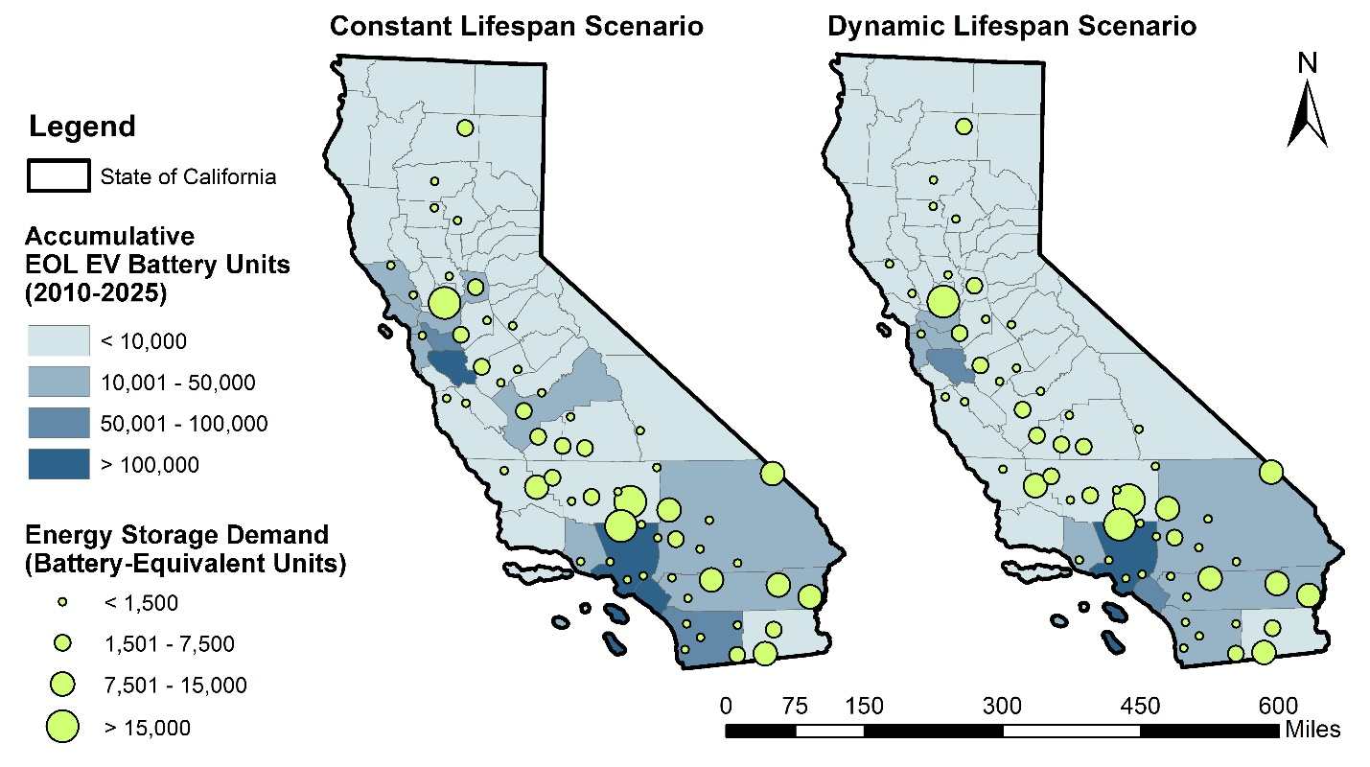
Accumulative EOL EV Batteries vs.
Potential Uses in California
31
Ning Ai, Junjun Zheng, and Weiqiang Chen (2019)

Slide 32
Summary

Slide 33
Policy Discussions
33
Sustainable policies need to be economically viable and sustainable.
Redistribution of costs and benefits necessitates careful examination.
Implementing local solutions would necessitate proactive facility planning and region-wide coordinated efforts.
Top-down and bottom-up approaches are both needed; education and innovation are critical.

Slide 34
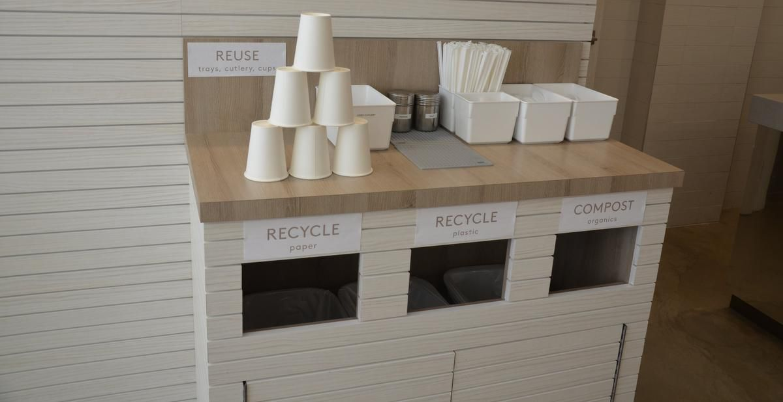
Where is the Garbage Can?
34
Parka Food Co.
https://www.thestar.com/life/2018/05/15/toronto-restaurant-takes-coffee-cup-recycling-into-their-own-hands.html
Notes:
https://www.thestar.com/life/2018/05/15/toronto-restaurant-takes-coffee-cup-recycling-into-their-own-hands.html

Slide 35

THANK YOU
Ning Ai 艾宁
美国伊利诺伊大学芝加哥分校
ain@uic.edu

Slide 36

A Metabolic View of Urban Sustainability
36
Stressors
Inputs
Close the Loop
Outputs
Population Growth
Energy
Air Emission
Land Development
Water
Solid Waste
Decreasing Life Span of Products
Food
Waste Water
Increasing Intensity of Material Use
Goods
Waste Heat
An urban system cannot be sustainable if it requires more resources than it can produce on its own and generates more wastes than the environment can assimilate.
Notes:
Growing proportion of population lives in cities. To support urban growth, intensified energy, water, and materials are needed. The residuals of urban production and consumption activities, such as waste, were “out of sight, out of mind.” Thomas Garver describes it as “Invisible Urbansim”: “[T]he products must still be made, the power generated, the water pumped, and the sewage treated… [B]ut let it be done elsewhere, and invisibly”
Moreover, “invisible” pressure has been resulted from urban population growth, land development and conversion, decreasing life span of products, and increasing intensity of material use.

Slide 37
Challenges of Policy Making
37
Local Efforts vs. Global Impacts
Efficiency vs. Equity
Short-Term vs. Long-Term Impacts
Limited Local Data vs. Regional Heterogeneity
  Impacts across environmental media, geographical boundaries, and academic and professional disciplines
Ning Ai and Nancey Green Leigh. “Planning for Sustainable Material and Waste Management.” American Planning Association Planning Advisory Service (PAS) Report #587. May 2017.

Slide 38
Drivers of Material & Waste Management (MWM)
4
Local environmental – treatment and disposal
Environmental
protection
Global Environmental – climate change
Public health - collection
Public health
Waste export & landfill diversion
Waste disposal capacity
Rediscover recycling
Resource value of the waste
Resource scarcity management
Facility siting- waste infrastructure
Social equity
Job creation – recycling, reuse & remanufacturing
Green jobs
1960
1970
1980
1990
2000
2010
2020
Ning Ai and Nancey Green Leigh. “Planning for Sustainable Material and Waste Management.” American Planning Association Planning Advisory Service (PAS) Report #587. May 2017.

