Slide 1
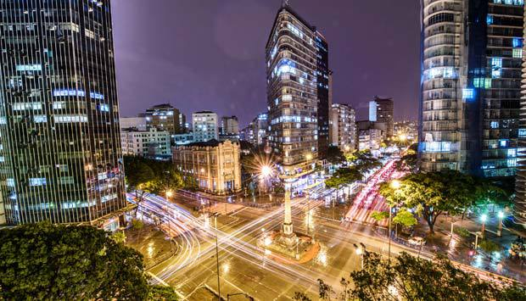
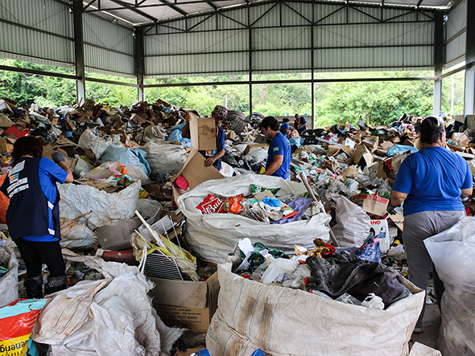
Ensuring an integrative and sustainable municipal solid waste management as part of strategies for a circular economy and sustainability – the case of Belo Horizonte
Urban metabolism in policy and practice: a global discussion
Beijing, July 7-11, 2019
Maryegli Fuss
Bing Image search
KIT – The Research University in the Helmholtz Association

Slide 2
Outline
1
INTRODUCTION
2
BELO HORIZONTE WASTE MANAGEMENT – a systemic overview
3
INTEGRATIVE AND SUSTAINABLE MUNICIPAL SOLID WASTE MANAGEMENT
– method approach
4
OVERLOOK FINDINGS
5
CONCLUDING REMARKS

Slide 3
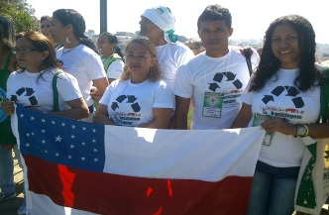
Introduction
Circular economy is an ambitious approach for large packaging Brazilian industries, while the municipal solid waste management (MSWM) is seen as an end-of-pipe sector of the urban system.
Core idea is to certify how concept of sustainability and circular economy (CE) measures could be a straightforward approach for socio-integrated MSWM.
The approach requires a proper understanding
of waste flows, recycling (and their impacts
in the society), principles of sustainability and CE.
Belo Horizonte

Slide 4
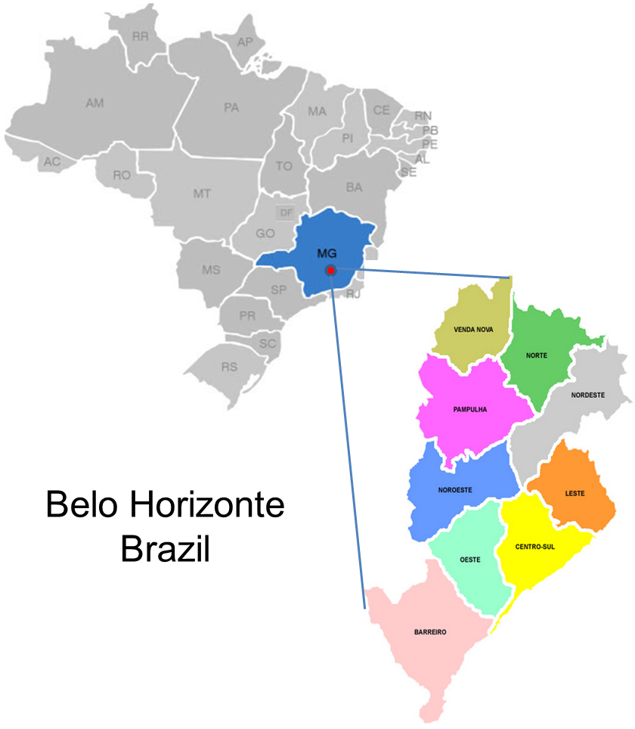
Belo Horizonte
Belo Horizonte* :
Area (Km²): 331.0
Climate: humid subtropical climate
Total Pop. (inhab.): 2,479,175
Population growth rate: 0.61% per year
MHDI: 0.731
Gini coefficient: 0.61
Ex. income inequality: 80% (low-high districts)
Solid waste management** :
Generation per capita: 0.784 (kg/(cap*day))
Collection coverage: 96%
Recycling coverage: 2%
Untreated waste disposal: 98%
*IBGE, 2014
** SLU 2014

Slide 5
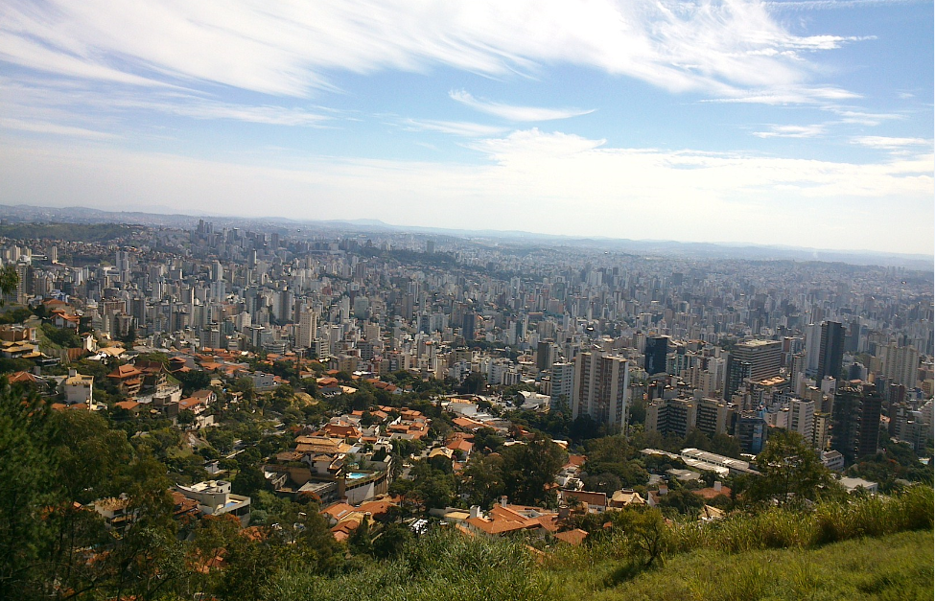
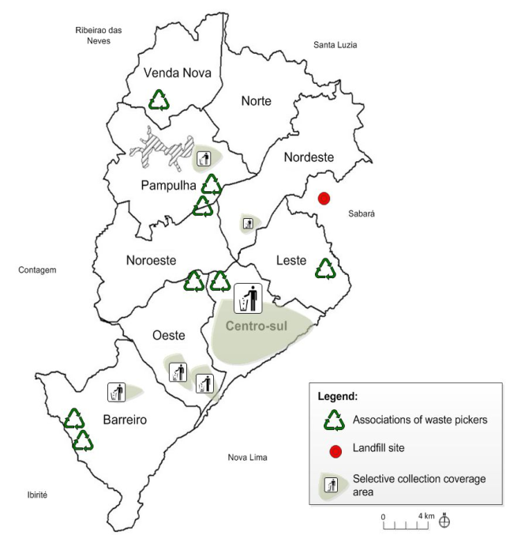
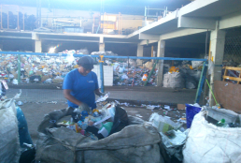
Belo Horizonte – a systemic overview
Belo Horizonte has 487 districts with divergent city development indexes from 0.62 (comparable with cities in India) to 0.95 (equivalent to cities in Finland), for example.
(Fonseca und Silva 2017) BH and the City development index, Transite news.
Belo Horizonte MSWM in the Literature:
International model of social integration of waste 'pickers cooperatives in MSWM by UN-Habitat (2010), Campos, H. (2014), Scheinberg, A. (2012)
Notes:
the fourth highest gross domestic product of Brazil (IBGE 2018) accompanied by sizeable industrial development in the primary (e.g. iron and steel mining), secondary (e.g. packaging industries) and tertiary sectors (e.g. biotechnology, and tourism jewelry

Slide 6


Integrative and sustainable municipal solid waste management – method approach
Applied Science: problem-solving oriented
Outcomes: Guidance and knowledge
Competences: Communication skills; Awareness: flexibility
Tools: Modelling- software
Resources
Management
Social Sciences
Notes:
You need not only to understand the flows and problems (physical), but to understand the agents behaviours and needs. At the same time, understand the sustainability aspects behind

Slide 7
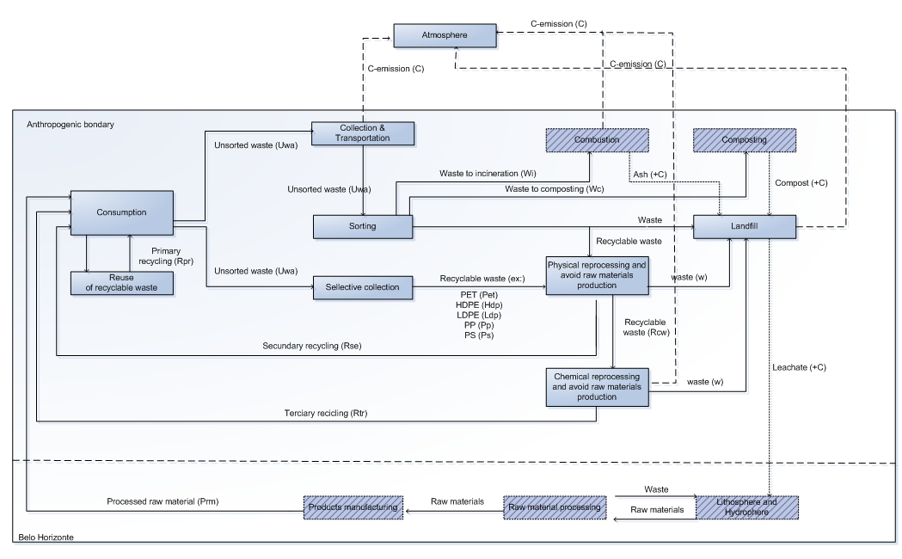
Material Flow analysis – an excerpt of the system definition
Mass-balance principle including consumption and entire waste management processes (multi-year based – 2004 – 2014).
Accounting the uncertainty in combination with gross error detection at the software STAN* where the multi-year MFA system model is built.
*STAN: Cencic, O. and H. Rechberger. 2008. Material Flow Analysis with Software STAN. 18th edition. 1 vol., Vol. 5. Aachen: Shaker.

Slide 8
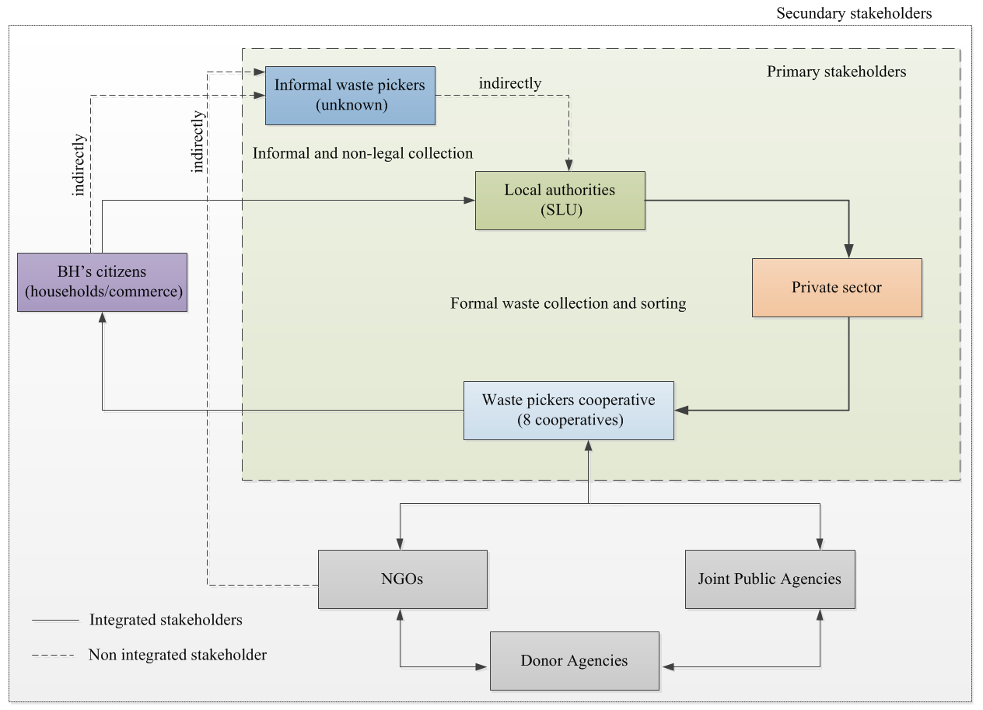
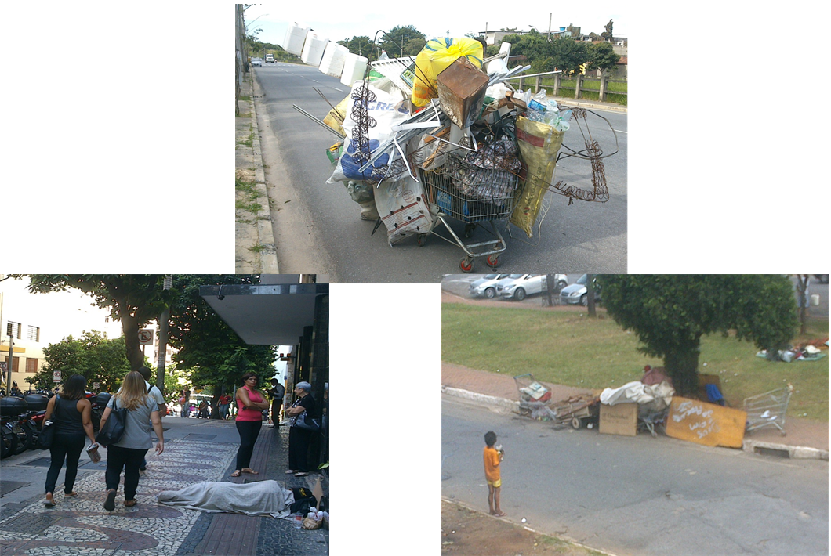
Belo Horizonte - an excerpt of the structure agent analysis
Image: Own files
Notes:
Urban metabolism -- how does urban metabolism thinking fit in to your work? Links can also more specifically be drawn to mass balancing / MFA / systems thinking.

Slide 9
Conceptualizing MSWM and ICoS
Capability approach
Conception
Concept
Integrated and sustainable MSWM
ICoS
Action vs. quality of life vs. further development
Improvement the quality of life, reinforce the capacity of humans to lead an active life
Present and future generation have to collaborate and receive equitable shares of public MSWM services (justice)
The global orientation and the responsibility to use existing resources
3R
Waste to
Energy
Meta-analysis
What is to sustain?
Why should it be sustained?
Who is concerned?
Zero
carbon
waste
Smart
system
Belo Horizonte integrated MSWM
Adequance condition
Notes:
ICoS gave the structural conditions to describe of what a concept is expected to sytematize under the challenges of Belo Horizonte, ie., I had a concept + adequance condition (case) and as a result I obtened the own conception to assist the problem towards sustainable development.
With the backbone of ICoS, the capability approach, It was framed key aspects which are relevant for the case (BH) merging action vs. Quality of life, further development
Actions have to be analysed it is misleading to start from the zero. THe transformation process needs to be analysed in a sence to figure out: * what is to sustain? Why should be sustained , who is concerned and in what respect replacement is allowed?

Slide 10
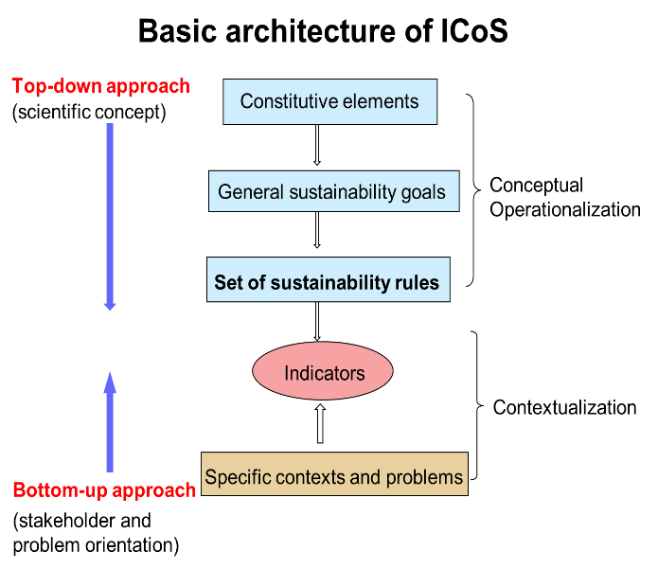
Integrated Concept of Sustainability (ICoS) in a nutshell and its application
Constitutive Elements of Sustainability
Maintaining society’s productive potential
(Environment - Material precondition)
“As a commitment that each stakeholder cluster of Belo Horizonte must have in relation to the Environment.”
Preserving society’s options for development and action
(Society – Non material precondition)
“As a precondition and compromise that all Belo Horizonte stakeholders clusters must have within and between generations”.
Securing human existence
(individual precondition)
“As a compromise that each individual stakeholder of Belo Horizonte solid waste management may have with the other in terms to claim for own rights, not leaving aside the duties.”

Slide 11
Constructing “Municipal Solid Waste Diagram”
MSWM criteria | Sustainability rules | Indicator | Target*
 |  |  | 0 | 2 | 5
Securing human existence „Improvement of life conditions and the welfare of agents“
Collaboration embedment among households and municipality for an urban cleanness and quality of life | Protection of human health | 1a – Share of households receiving basic waste collection services weekly |  |  | x
Maintaining society’s productive potential „Preserving resources“
Strategic alternatives for waste transportation paths | Sustainable use of non-renewable sources | 2c. Share of each district area served per type of vehicles with non-fossil fuel |  | x
3
Goals
15
Rules
9
Criteria
18 Indicators
ICoS
E
X
C
E
R
P
T
Case-study
*Target: level of development 0 (weak): 0-35% 2 (intermediate): 35-65% 5 (advanced): < 65%
Fuss, M.; Vasconcelos, B.R.T.; Poganietz, W-R. (2018) Designing a framework for municipal solid waste management towards sustainability in emerging-economy countries - An application to a case study in Belo Horizonte (Brazil). Journal of Cleaner Production(178): 655–664
Notes:
From of semi-quantitative assessment_
I intend to explain in details the processes done to build the scientific base-tool : Municipal Solid Waste Diagram
Protection of human health – Human health must be protected from antropogenic environmental burdening of hazards and unacceptable risks caused by MSWM.
BH participants for criteria selection: 34 (23 experts and 9 stakehoders)
Indicators: 85 were contacted and 28 answered

Slide 12
Core findings
Material flow analysis
Aluminum cans, non-ferrous composing-product, polyethylene bottles, and cardboard are the commodities that reached closed-loop recycling
Recyclable waste generation increased by 65% compared to the base year and a maximum total collection was 290 kt/a ± 2%, a growth of 3.12% annually
Agent structure analysis
Three regulatory structures make an influence on waste pickers as a crucial agent for the NPSW: cultural values, market mechanism, and legislation.
Cultural values, imposed by the sociocultural structure into social classes, are playing the leading role in their self-organization;
Sustainability assessment
Belo Horizonte has obtained a level of development of
30% towards sustainability currently.
Households are committed to protecting human health by collaborating with basic services for urban cleanness
Belo Horizonte presented diverse ways to recover each type of RBMs, due to the separation made exclusively by waste pickers manually
A supply of secondary resources cannot be ensured due to the dispute between the public sector and industry regarding the responsibilities with recycling costs.
Obtain income from own work. The co-benefits of recovering secondary resources needs to be strengthen among households.
Notes:
A supply of secondary resources cannot be ensured due to the dispute between the public sector and industry regarding the responsibilities with recycling costs. Therefore, there is a pattern to follow for each specific RBMs in Brazil. Closed-loop recycling is allowed for metal and glass packaging because of their high durability, mechanical resistance (without losing quality) and well-set standardized decontamination procedures

Slide 13
Concluding remarks
①
Socio-integration, CE and sustainability
  The collaboration guarantees no child labor, assists in securing an autonomous existence (rule of ISMSW) through fair income based on minimum local salary, and additionally avoids competitive efforts among waste pickers in cooperatives.
②
Interacting stakeholders and decision makers
  Joint constructing and applying the Municipal Solid Waste Diagram helped to improve the acceptance of actions vs. integrated sustainability by stakeholders and decision-makers in Belo Horizonte.
③
Recommendations for emerging-countries
  Recognize waste as a problem by the relevant stakeholders. Structured platform of communication with formal and informal representatives. Criteria and indicators can be updated by the method described in this study.

Slide 14
Thank you for your attention!
Maryegli Fuss
maryegli.fuss@kit.edu

