Slide 1
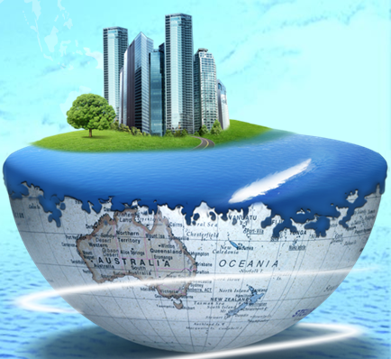
Rethinking Urban Metabolism: Back to the Perspective of Biology/Ecology
Dr./Pro. Lixiao ZHANG
School of Environment, Beijing Normal University
2019-07-05

Slide 2
Contents
The development of concept metabolism
Reviews of urban metabolism research
From metaphor to real research domain

Slide 3
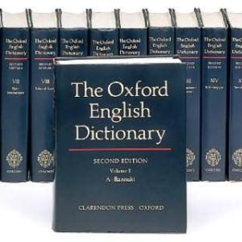
The development of ‘metabolism’ concept
Metabolism means ’the chemical processes that occur within a living in order to maintain life’ .
It finds its etymology in the Greek word metabole, meaning change.
The notion of metabolism therefore refers to a process of changes that keep a
system alive, which explains its initial use in ecology and biophysical sciences.

Slide 4
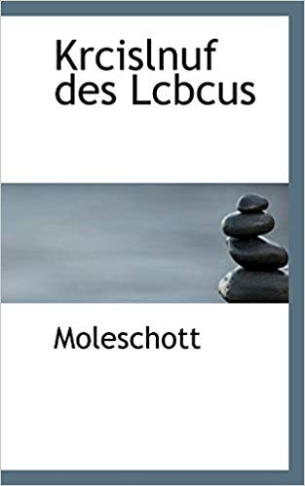
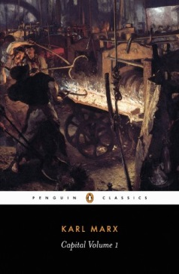
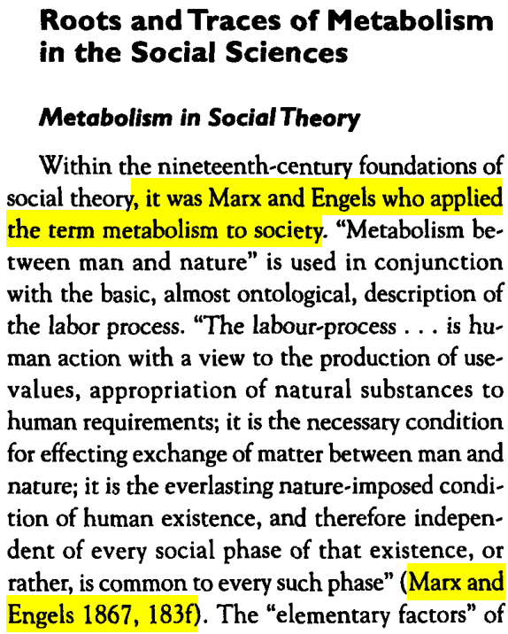
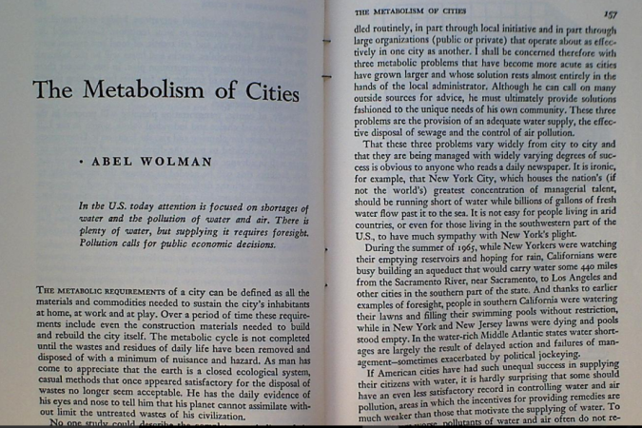
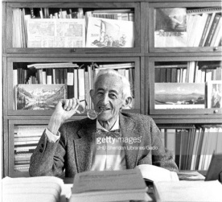
From biology science to urban metabolism
1852
1867
1965
The Circle of Life
Capital 1
Moleschott
Marx and Engels

Slide 5
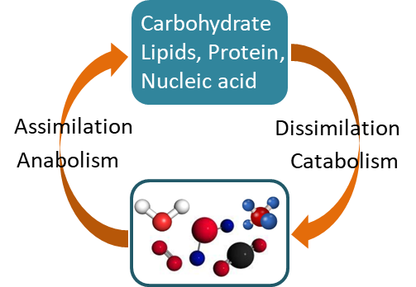
Metabolism in Biology
All the chemical processes by which food and its derivatives are broken down to yield new building
blocks and energy. This segment of metabolism is
termed catabolism.
All the chemical processes by which living cells and tissues are produced and built up. This is anabolism (buildup of new molecules by biosynthesis).

Slide 6
Reviews of urban metabolism research
Time
Detailed model
Rise Period
(2001 to the Present)
Examined the inner workings
of the urban system in increasing details
Growth Period
(1981 to 2000)
Subsystem model
Opening the black box
Initial Period
1965 to 1980
Black box model
Considering only overall inputs and outputs
Model

Slide 7
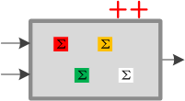
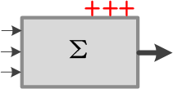
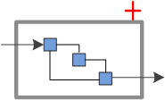
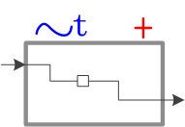
Reviews of urban metabolism research
Multi-factor Inventory Analysis (No system summation) (Food, Water, Construction Materials, Waste Emissions )
Boyden et al., 1981; Hendriks et al.,2000; Sahely et al.,2003; Lebel et al., 2007
Material Flow Analysis, Energy Flow Analysis (using either mass or energy units to quantify the flows of materials and energy through an urban system)
Baccini and Brunner,1991; Schandl et al.,2002; Huang,1998; Huang and Chang, 2015
Emergy analysis method(using a consistent system of units, and then comparing different kinds of flows (materials, energy, and currency)
Odum, 1996; Huang et al., 1995; Huang and Hsu, 2003; Pulselli et al., 2008; Lei et al., 2016
Stock and flow analysis(Modeling paradigm is provided)
Sahely et al., 2003; Johnson et al., 2005; Van Beers et al., 2007; Hu et al., 2010；Zank et al., 2016; Chen and Graedel, 2015
System dynamics modeling (Dynamo、Vensim、Stella)
Lei and Wang, 2008; Liu et al., 2012;
Notes:
In 1965, Wolman, a water treatment expert, introduced the concept of an urban metabolism into the study of socioeconomic systems and used this framework to understand urban development’s effect on the environment.
He treated the city as an organism with the equivalent of metabolic processes and defined urban metabolism as the inputs of materials and energy into the urban system and the emission of wastes by the system.

Slide 8
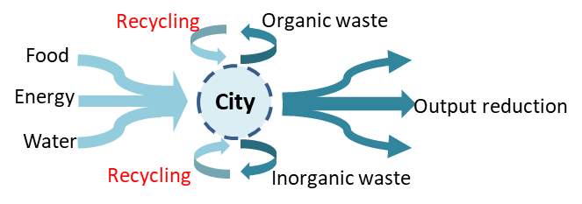
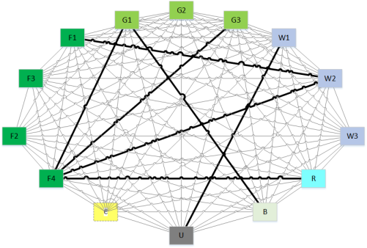
Reviews of urban metabolism research
Linear
processes
Cyclic
processes
Urban metabolism
Network
models
Notes:
input-output metabolic model
Transform wastes into resources

Slide 9
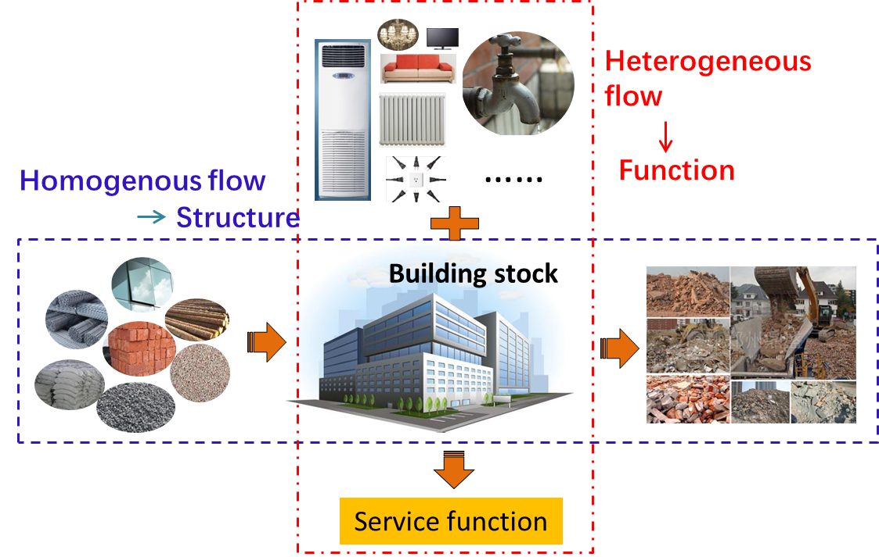
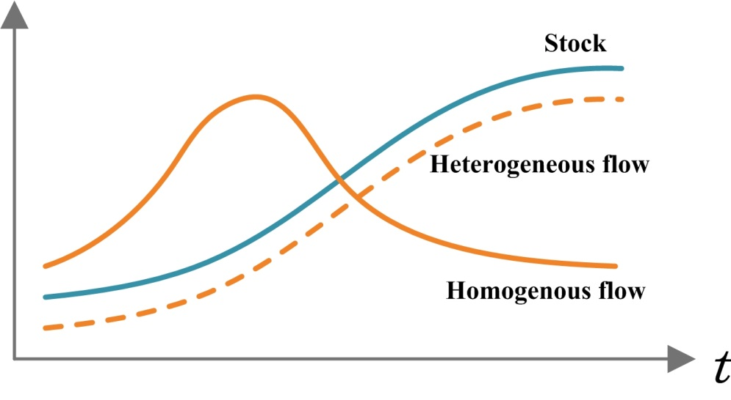
Anabolism/Catabolism vs Homogenous/Heterogeneous Inputs

Slide 10
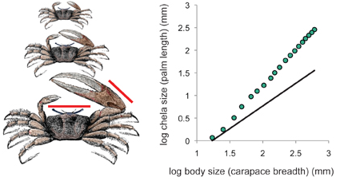
Driving factor: is there Allometry rule?
Allometry is a well-known study, particularly in statistical shape analysis for its theoretical developments, as well as in biology for practical applications to the differential growth rates of the parts of a living organism's body.
Overall metabolic rate in animals is generally accepted to show negative allometry, scaling to mass to a power of ≈ 0.75, known as Kleiber's law, 1932
What is the affecting factor for urban metabolism(e.g., building, food…)? GDP, Population or even topography?

Slide 11
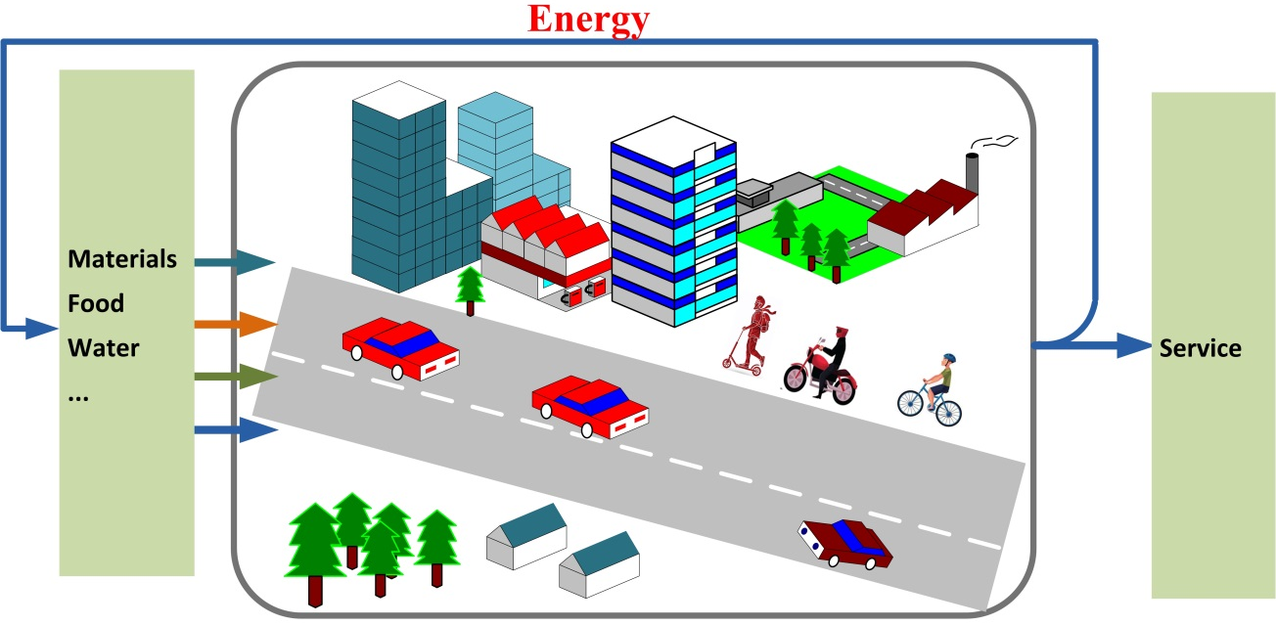
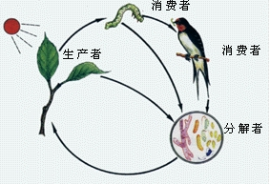
Urban Mining: Energy Make Circular Happen
Natural ecosystem
Urban system
Primary consumers
Producers
Secondary
consumers
Decomposers
Can urban system be sustained by resource recycling with external energy inputs?

Slide 12
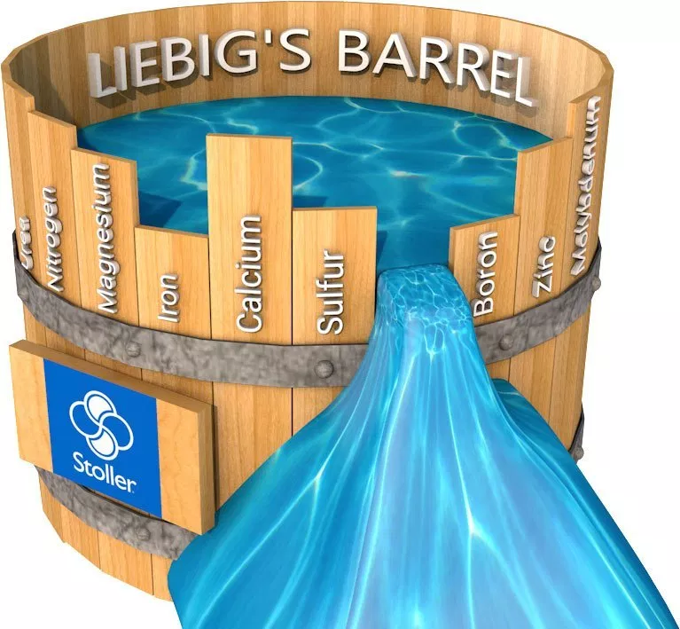
Thinking more for urban metabolism

Slide 13
The urban metabolism metaphor greatly promoted our understanding to the mechanism of urban material and energy exchange with nature.
We still need go beyond the current paradigm to refer to rich biological/ ecological knowledge, to shift from metaphor to a real research domain.

Slide 14
Many thanks！
E-mail: zhanglixiao@bnu.edu.cn

