Slide 1

Unlocking the informal economy in an inclusive circular economy approach
Urban Metabolism Seminar
06 July 2019, Beijing
Notes:
The challenge:
Over 80 per cent of marine plastic waste comes from land-based sources, making plastic the most common type of marine litter.
Countries with fast growing markets and underdeveloped waste management systems in Asia may be responsible for as much as 60 per cent of global plastic waste leakage, including India and Thailand among the top 10-15 polluters worldwide (still very little data, challenge may even big bigger). Over half of global land-based plastic waste leakage into the ocean originates in just five Asian countries. Yet, the contribution of informal waste management to reducing pollution, remains largely overlooked.
Plastic pollution is a transboundary issue—up to 95 per cent of plastic in our ocean is transported by ten major rivers, eight of which are in Asia.
Activities: Building on the evidence ground-truthed in pilot cities of Pune in India and Bangkok in Thailand as part of the Section 23 project ‘Closing the Loop’, scale up the three existing assessments of waste value chains to additional cities in Asia and the Pacific, and expand the depth of this assessment by including other actors in the waste plastic chain, such as private sector technology providers and businesses. With these enhancements, design a decision-support tool to help cities identify under-performing sectors, evaluate improvement and cost-saving potential, and prioritize sectors and actions for intervention. The tool could identify actions that offer the greatest impact potential, and an intervention selection module which functions like a “playbook” of different tried-and-tested plastic management measures building on good practice case studies to help select locally appropriate interventions. The process starts with crowd sourced data collection, goes through an on-location assessment involving experts, decision makers, waste actors and ends with a final report to city authorities with recommendations of interventions tailored to the city’s individual context.

Slide 2
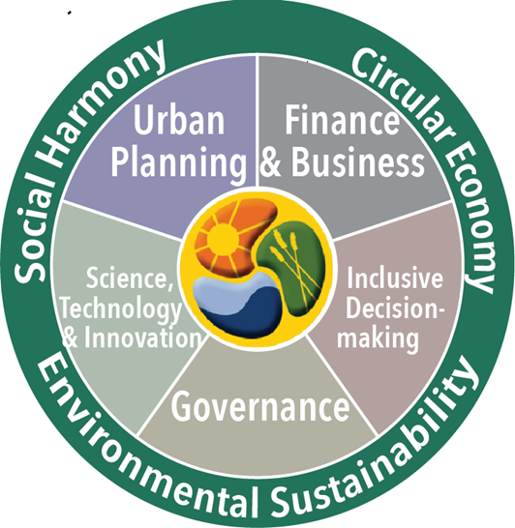

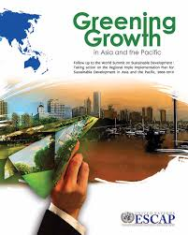
who we are
Economic and Social Commission for Asia and the Pacific
Regional development arm of the UN, HQ in Bangkok
62 members & associate members – from Turkey to Tonga
Foster sustainable development in line with the 2030 Agenda
Policy dialogue, technical assistance, capacity building, research, coordinating role, regional cooperation through intergovernmental processes
Notes:
Interdisciplinary work to support governments to achieve SDGs: economic, environmental, social
Leaving no one behind – inclusive approaches to regional challenges, build partnerships, coordinate, connect with larger policy frameworks

Slide 3
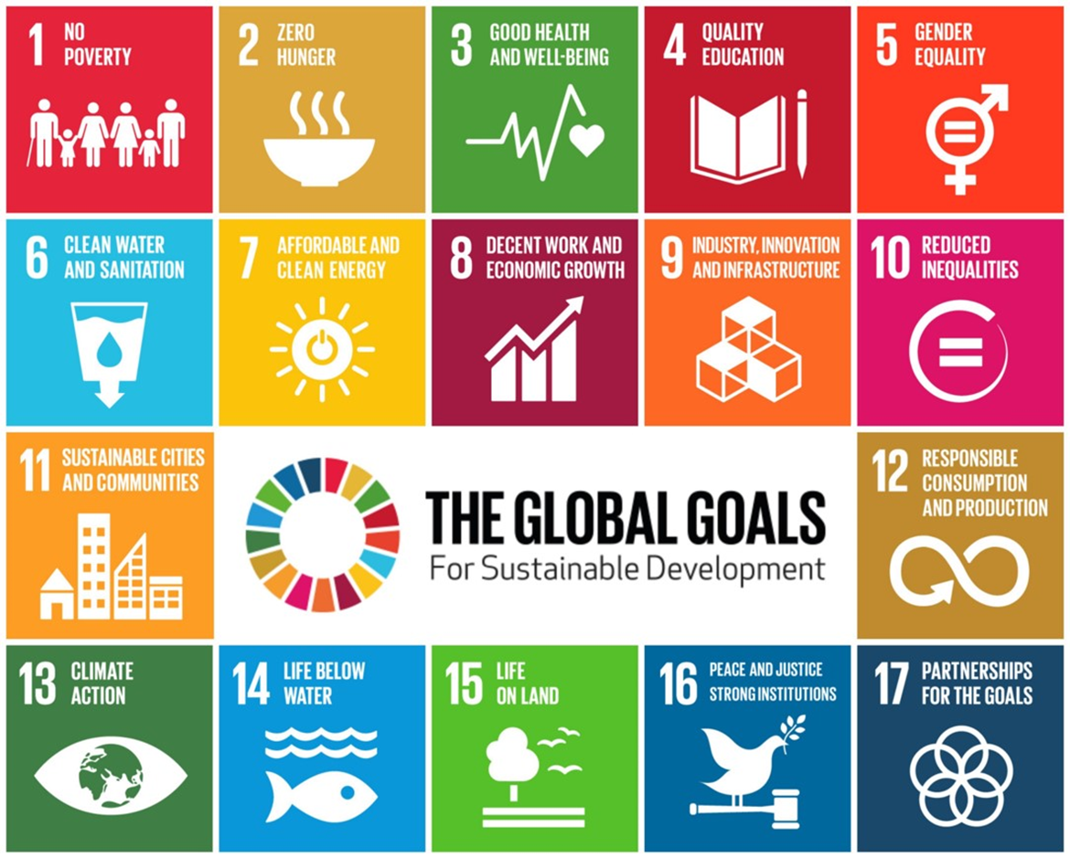
2030 Agenda for Sustainable Development
Notes:
Interdisciplinary work to support governments to achieve SDGs: economic, environmental, social
Leaving no one behind – inclusive approaches to regional challenges, build partnerships, coordinate, connect with larger policy frameworks

Slide 4
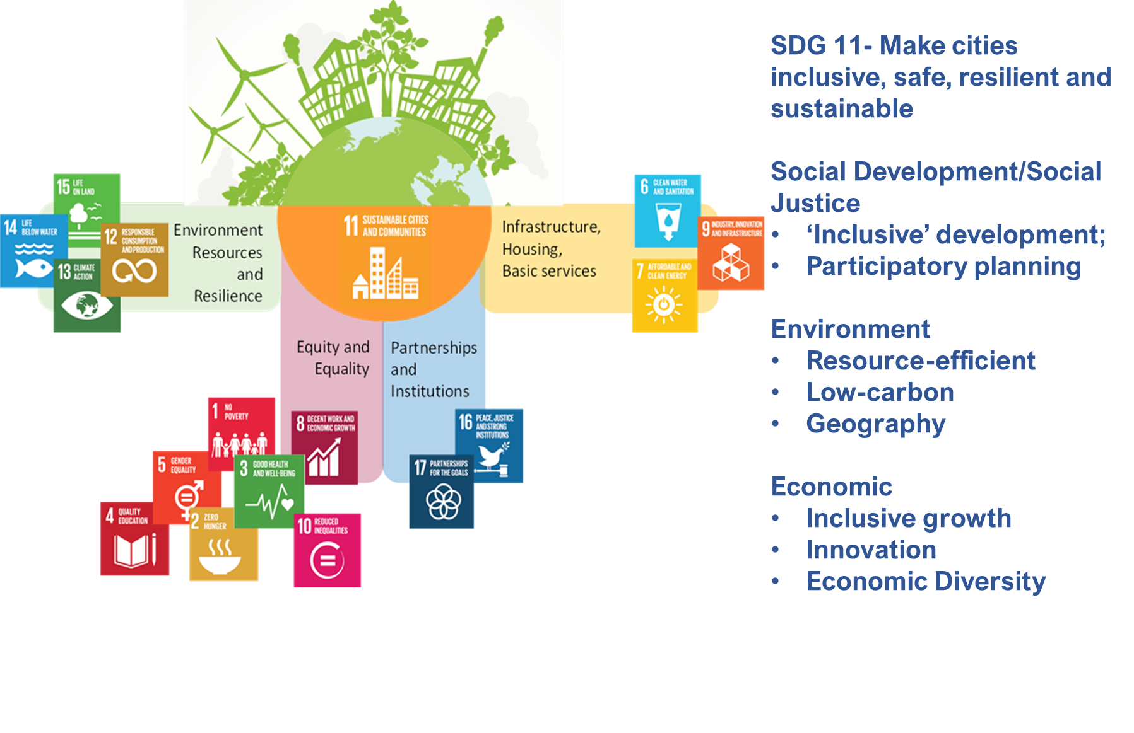
Cities and SDGs
Source: Otto, UN Environment, Cities Unit
Notes:
Interdisciplinary work to support governments to achieve SDGs: economic, environmental, social
Leaving no one behind – inclusive approaches to regional challenges, build partnerships, coordinate, connect with larger policy frameworks

Slide 5
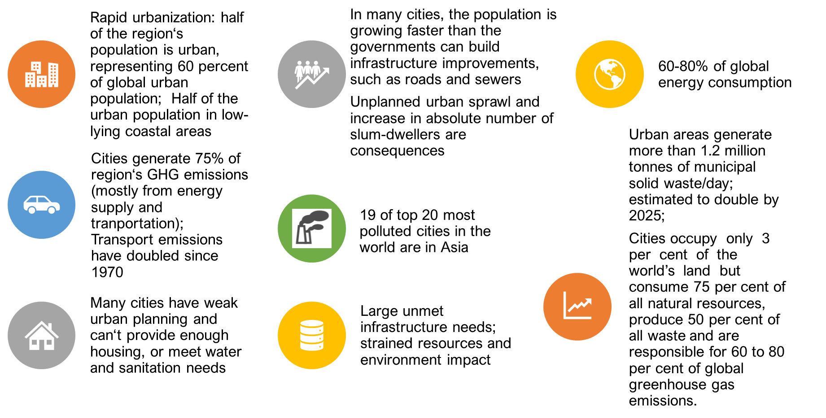

Cities in Asia Pacific
Notes:
Interdisciplinary work to support governments to achieve SDGs: economic, environmental, social
Leaving no one behind – inclusive approaches to regional challenges, build partnerships, coordinate, connect with larger policy frameworks

Slide 6
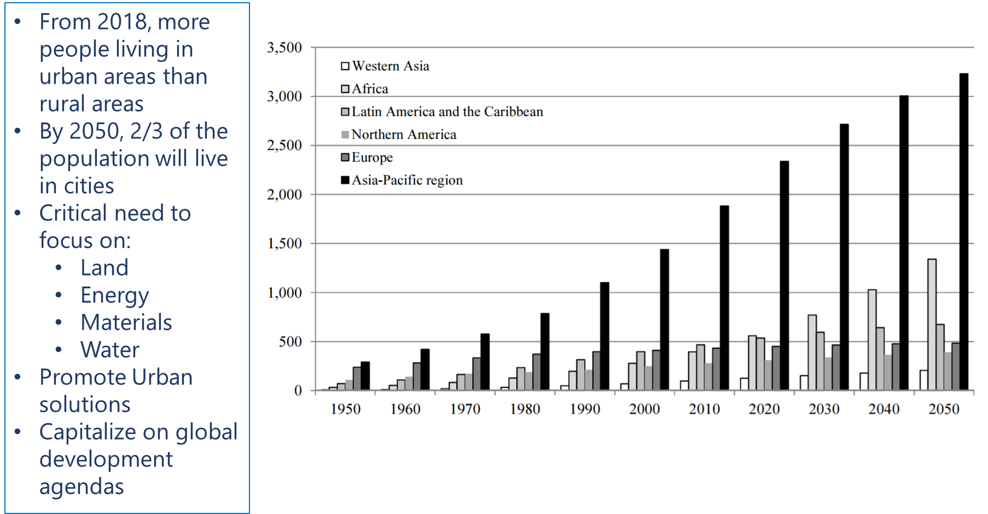
Cities in Asia Pacific
Urban population at mid-year (Thousands), UN-DESA
Notes:
Interdisciplinary work to support governments to achieve SDGs: economic, environmental, social
Leaving no one behind – inclusive approaches to regional challenges, build partnerships, coordinate, connect with larger policy frameworks

Slide 7
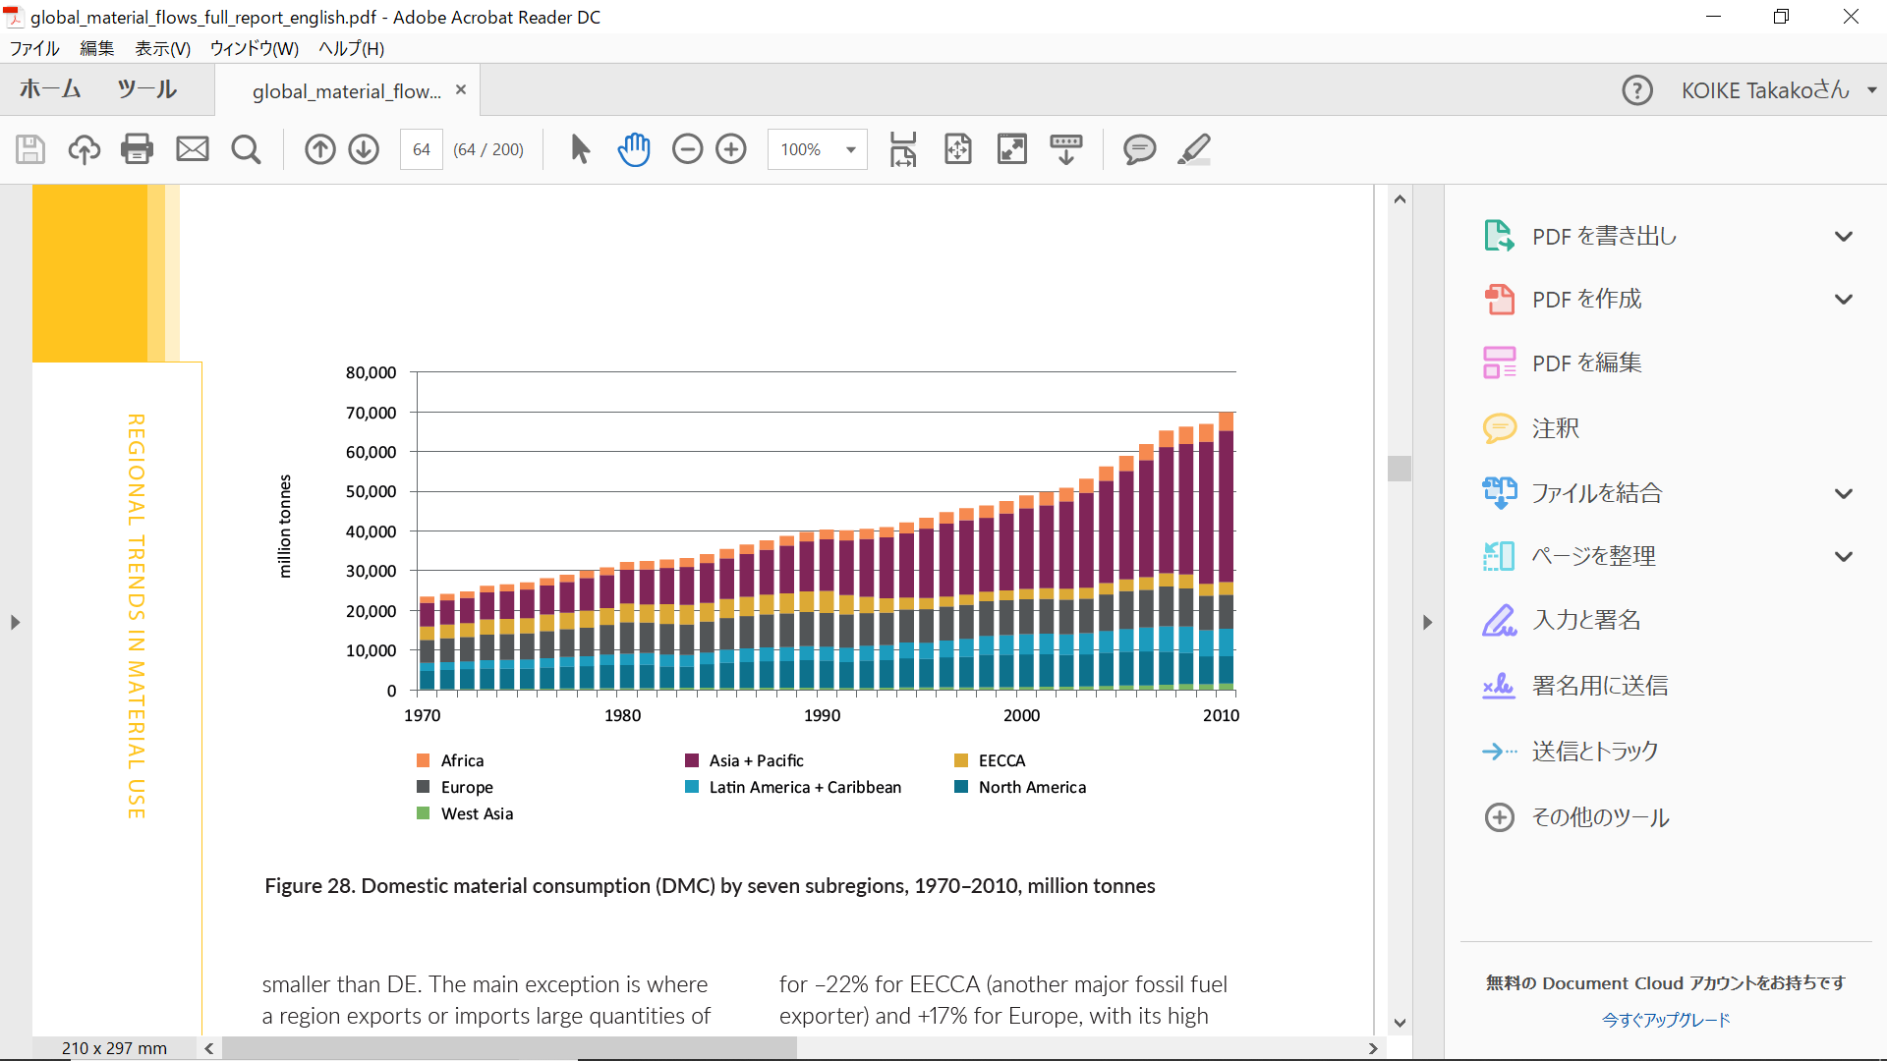
Cities in Asia Pacific
Domestic material consumption (DMC) by seven subregions
Notes:
Interdisciplinary work to support governments to achieve SDGs: economic, environmental, social
Leaving no one behind – inclusive approaches to regional challenges, build partnerships, coordinate, connect with larger policy frameworks

Slide 8
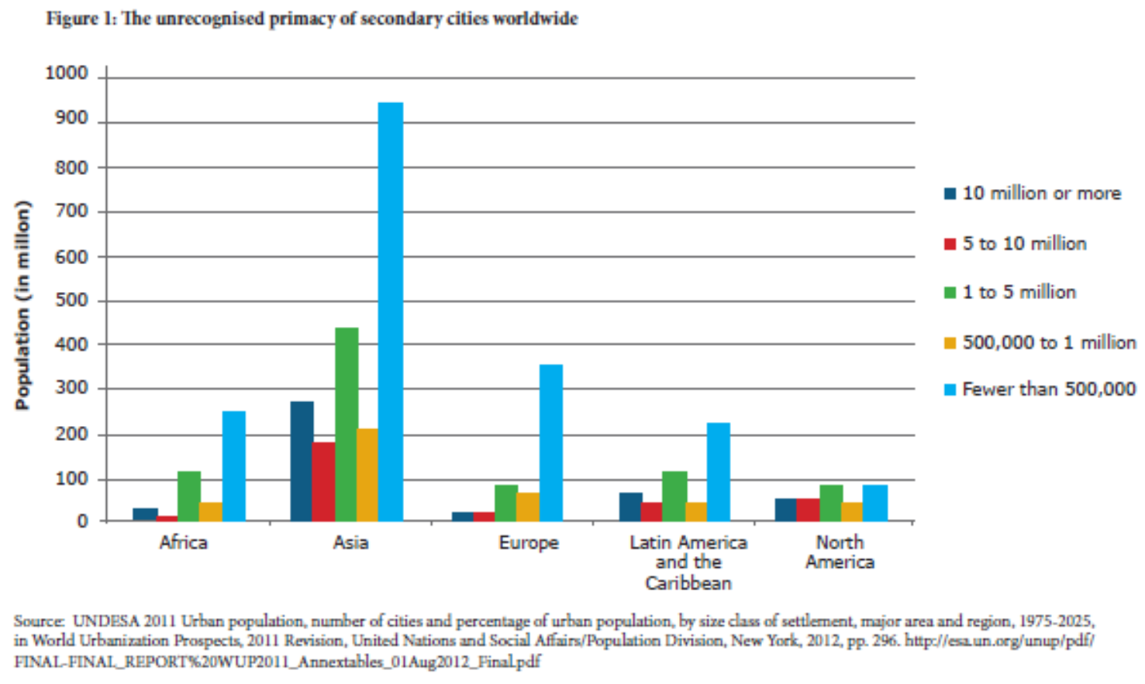
Cities in Asia Pacific
Notes:
Interdisciplinary work to support governments to achieve SDGs: economic, environmental, social
Leaving no one behind – inclusive approaches to regional challenges, build partnerships, coordinate, connect with larger policy frameworks

Slide 9
the challenge of plastic waste
Notes:
Interdisciplinary work to support governments to achieve SDGs: economic, environmental, social
Leaving no one behind – inclusive approaches to regional challenges, build partnerships, coordinate, connect with larger policy frameworks

Slide 10
the challenge of plastic waste
Local SWM and resource flows have regional and global impact
McKinsey & Company and the Ocean Conservancy estimated in 2015 that five Asian countries – China, Indonesia, the Philippines, Thailand and Viet Nam– may account for up to 60 per cent of the plastic waste leaking into the Pacific Ocean¹
1. See https://oceanconservancy.org/trash-free-seas/plastics-in-the-ocean/.
McKinsey & Company and Ocean Conservancy, 2015.
Notes:
Interdisciplinary work to support governments to achieve SDGs: economic, environmental, social
Leaving no one behind – inclusive approaches to regional challenges, build partnerships, coordinate, connect with larger policy frameworks

Slide 11
understanding the materials
What is in the market, and what is marketable?
What are the technical solutions? mechanical recycling; chemical recycling; waste to energy
Production alternatives: plastic from alternative feedstocks to fossil fuels (e.g. starch and vegetable based biodegradables)
Plastics to new products
Notes:
Interdisciplinary work to support governments to achieve SDGs: economic, environmental, social
Leaving no one behind – inclusive approaches to regional challenges, build partnerships, coordinate, connect with larger policy frameworks

Slide 12
understanding waste flows
Actors involved in plastic waste management in Bangkok
Mapping of waste flows- who is doing what and where?
Where are the intersections of informal and formal sectors?
Lack of data on informal sector
Quantifying value of diversion and savings to local SWM
Notes:
Interdisciplinary work to support governments to achieve SDGs: economic, environmental, social
Leaving no one behind – inclusive approaches to regional challenges, build partnerships, coordinate, connect with larger policy frameworks

Slide 13
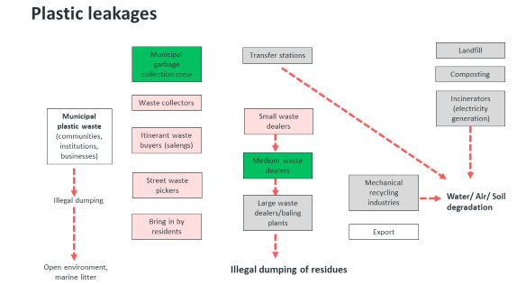

understanding waste flows
Notes:
Interdisciplinary work to support governments to achieve SDGs: economic, environmental, social
Leaving no one behind – inclusive approaches to regional challenges, build partnerships, coordinate, connect with larger policy frameworks

Slide 14
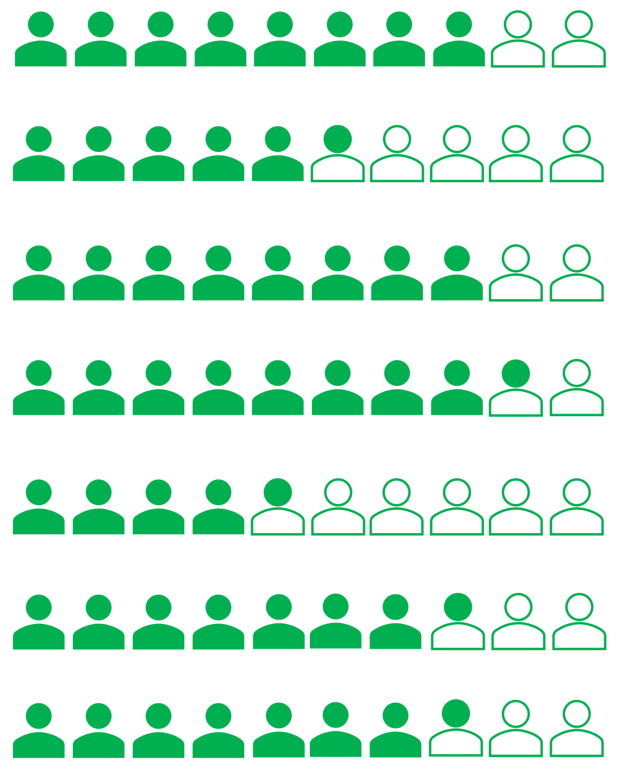

why the informal?
– South Asia: 82%
– East & Southeast Asia: 65%
– Pakistan: 78%
– India: 85%
– Thailand: 43%
– Indonesia: 73%
– Viet Nam: 86%
data source: ILO
Notes:
Informal definition: the informal economy is the broad base of the global economy and workforce and the main generator of jobs and livelihoods in most cities in the developing world (homebased workers, street vendors, motorcycle drivers, waste pickers)
The informal is the invisible work force of our hybrid economies – it serves the formal, but is often overlooked, even though in many places especially in South and Southeast Asia it IS the economy where most people –especially the urban poor- earn their living (incomes are low, risks are high)
The informal economy accounts for more than half of non-agricultural employment: South Asia 82%, East- and South-East Asia: 65%
Informal employment as a % of non-agricultural employment
Pakistan: 78%
India: 85%
Thailand: 43%
Vietnam: 68%
Indonesia: 73%
China (6 Cities): 32% (% of total employment)
CLICK: this includes informal waste managers – waste pickers
Data source: WIEGO – Women in Informal Emploment Globalizing & Organizing

Slide 15
why the informal?
More than 15 million people globally earn their income informally in the waste sector
In low-income countries, informal waste-pickers collect 50-100% of waste at no cost to municipalities
Source: UN-Habitat
Notes:
Informal definition: the informal economy is the broad base of the global economy and workforce and the main generator of jobs and livelihoods in most cities in the developing world (homebased workers, street vendors, motorcycle drivers, waste pickers)
The informal is the invisible work force of our hybrid economies – it serves the formal, but is often overlooked, even though in many places especially in South and Southeast Asia it IS the economy where most people –especially the urban poor- earn their living (incomes are low, risks are high)
The informal economy accounts for more than half of non-agricultural employment: South Asia 82%, East- and South-East Asia: 65%
Informal employment as a % of non-agricultural employment
Pakistan: 78%
India: 85%
Thailand: 43%
Vietnam: 68%
Indonesia: 73%
China (6 Cities): 32% (% of total employment)
CLICK: this includes informal waste managers – waste pickers
Data source: WIEGO – Women in Informal Emploment Globalizing & Organizing

Slide 16


Closing the Loop
generate evidence in pilot cities
understand the plastic waste value chain (Material Flow and Social Impacts)
informal contributions: collection, sorting, scrap shops, recycling
where do informal activities & the formal system meet?
what are challenges & opportunities to improve process?
case study, policy guidance, regional dialogue
identify inclusive solutions
build partnerships between informal stakeholders and actors across the value chain
increase recovery & recycling & reduce plastic waste leakage
Notes:
The challenge:
Over 80 per cent of marine plastic waste comes from land-based sources, making plastic the most common type of marine litter.
Countries with fast growing markets and underdeveloped waste management systems in Asia may be responsible for as much as 60 per cent of global plastic waste leakage into the ocean.
Formal waste management systems achieve low recycling rates
Plastic goes to landfills & the environment & is lost as a valuable resource, threatens ecosystems, health, and public budgets
Yet, the contribution of informal waste management to reducing pollution, remains largely overlooked.
Our project - Generate evidence in 2 pilot cities - Pune and Bangkok:
Understand the plastic value chain
What is the contribution to recycling & reducing pollution (from collection to sorting and selling)?
Where in the plastic waste value chain do the informal and formal intersect?
What are challenges and where can the process be improved by understanding, acknowledging and including the informal contributions?
Identify solutions:
How can we improve waste management by including informal waste efforts? → build more inclusive waste management systems that reduce plastic waste leakage and improve recovery and recycling rates as part of a larger circular economy approach
Build multi-stakeholder partnerships

Slide 17
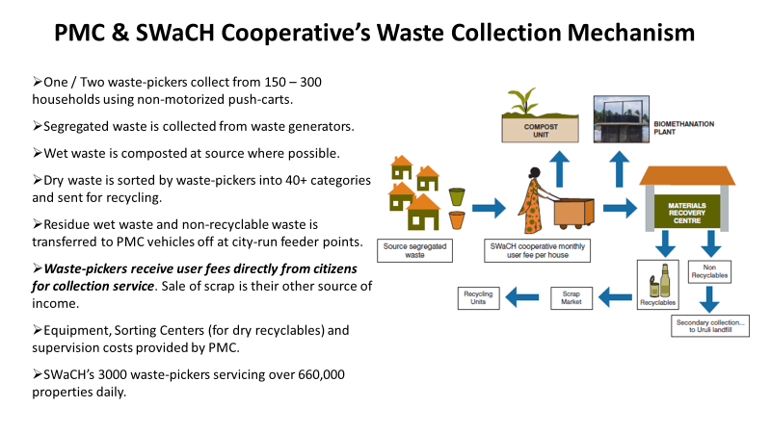

the case of Pune, India
Kagad Kach Patra Kashtakari Panchayat
Notes:
Interdisciplinary work to support governments to achieve SDGs: economic, environmental, social
Leaving no one behind – inclusive approaches to regional challenges, build partnerships, coordinate, connect with larger policy frameworks

Slide 18
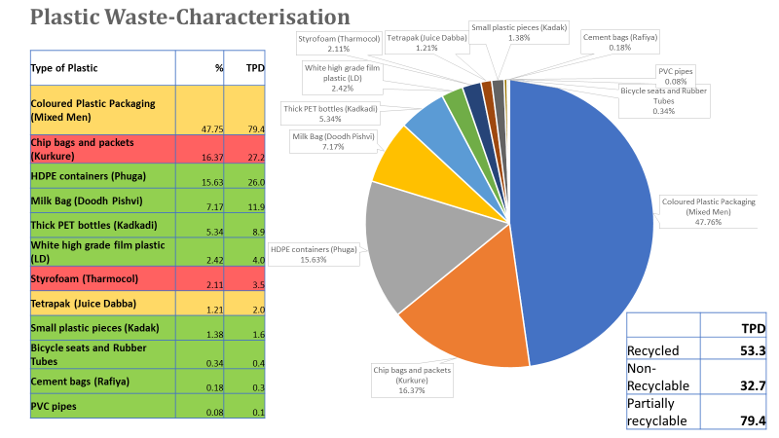



the case of Pune, India
Notes:
Interdisciplinary work to support governments to achieve SDGs: economic, environmental, social
Leaving no one behind – inclusive approaches to regional challenges, build partnerships, coordinate, connect with larger policy frameworks

Slide 19
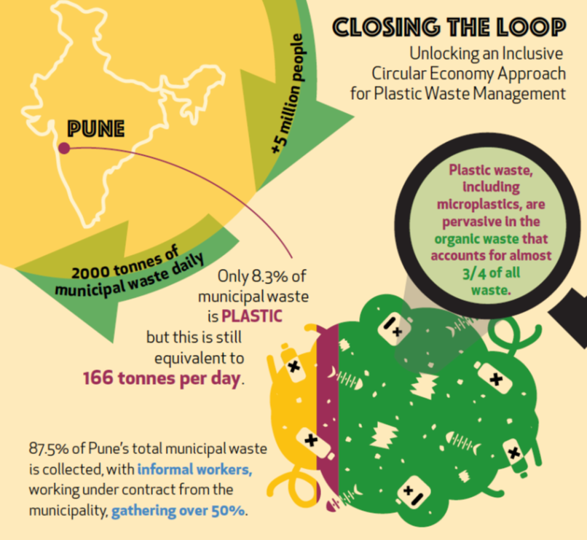
the case of Pune, India
Notes:
Interdisciplinary work to support governments to achieve SDGs: economic, environmental, social
Leaving no one behind – inclusive approaches to regional challenges, build partnerships, coordinate, connect with larger policy frameworks

Slide 20
the case of Pune, India
Notes:
Interdisciplinary work to support governments to achieve SDGs: economic, environmental, social
Leaving no one behind – inclusive approaches to regional challenges, build partnerships, coordinate, connect with larger policy frameworks

Slide 21
the case of Pune, India
Notes:
Interdisciplinary work to support governments to achieve SDGs: economic, environmental, social
Leaving no one behind – inclusive approaches to regional challenges, build partnerships, coordinate, connect with larger policy frameworks

Slide 22
the case of Pune, India
Notes:
Interdisciplinary work to support governments to achieve SDGs: economic, environmental, social
Leaving no one behind – inclusive approaches to regional challenges, build partnerships, coordinate, connect with larger policy frameworks

Slide 23
the case of Pune, India
Notes:
Interdisciplinary work to support governments to achieve SDGs: economic, environmental, social
Leaving no one behind – inclusive approaches to regional challenges, build partnerships, coordinate, connect with larger policy frameworks

Slide 24
the case of Pune, India
Notes:
Interdisciplinary work to support governments to achieve SDGs: economic, environmental, social
Leaving no one behind – inclusive approaches to regional challenges, build partnerships, coordinate, connect with larger policy frameworks

Slide 25
the case of Bangkok
Notes:
Interdisciplinary work to support governments to achieve SDGs: economic, environmental, social
Leaving no one behind – inclusive approaches to regional challenges, build partnerships, coordinate, connect with larger policy frameworks

Slide 26
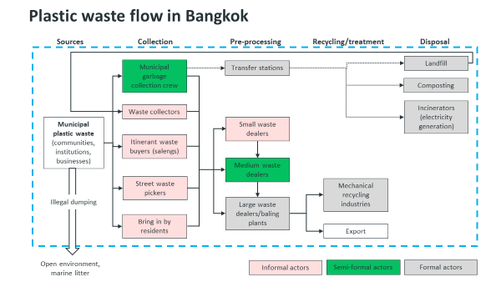
the case of Bangkok
Source: Stockholm Environment Institute
www.sei.org/centres/asia/
Notes:
Interdisciplinary work to support governments to achieve SDGs: economic, environmental, social
Leaving no one behind – inclusive approaches to regional challenges, build partnerships, coordinate, connect with larger policy frameworks

Slide 27
Regional Guide: Unlocking the informal economy to recover plastic waste and reduce marine pollution as part of an inclusive circular economy approach
Building on the case studies, workshops and experiences from Pune, Bangkok and others, this dialogue provides inputs for a practical guidance tool of evidence-based policy recommendations for local and national policy makers to foster an inclusive circular economy approach
    To include analysis on plastic waste typologies (material analysis), process dynamics (value chain), innovations (smart apps), new partnerships (informal workers), challenges (leakages), policies (bans)
    Recommendations for: Policy, Practice, Research and Regional Cooperation

Slide 28
Regional Guide: Unlocking the informal economy to recover plastic waste and reduce marine pollution as part of an inclusive circular economy approach

Slide 29
Regional Guide: Unlocking the informal economy to recover plastic waste and reduce marine pollution as part of an inclusive circular economy approach

Slide 30
Thank you!
contact us: curt.garrigan@un.org

